Slide 1
SOCCER AID FOR UNICEF ACADEMY 2025

Slide 2
Child-Friendly Spaces
Notes:
WARNING: This lesson features content that may be upsetting for some children. Please review content (especially the video on slide 5) before delivering the lesson to determine whether it will be suitable for your audience. Consider at-risk and refugee children who may have experienced some of the issues discussed. The final slide of the PowerPoint provides signposting for support. Please complete the missing information to be relevant to your setting.

Slide 3
Aims:
To understand how UNICEF protects children’s rights globally, including the right to play
To understand impact of being involved in the Soccer Aid School’s Academy
To understand the importance of child friendly spaces (focussing on the importance of education)
To understand the importance of inclusion

Slide 4

Notes:
Teacher notes:
Re-cap last lesson.
Which right did we focus on last time? Answer on next slide….
The United Nations Convention on the Rights of the Child (CRC) is the basis of all UNICEF’s work. The CRC sets out the human rights of every person under the age of 18. It was adopted by the UN General Assembly in 1989 and is the most widely agreed international human rights treaty in history. The UK signed the convention on 19 April 1990, ratified it on 16 December 1991 and it came into force on 15 January 1992. The Convention has 54 articles that cover all aspects of a child’s life and set out the rights that all children everywhere are entitled to. It also explains how adults and governments must work together to make sure all children can enjoy all their rights. Every child has rights, whatever their ethnicity, gender, religion, language, abilities or any other status. The Convention must be understood as a whole: all rights are linked and no right is more important than another. The right to relax and play (article 31) and the right to freedom of expression (article 13) are as important as the right to be safe from violence (article 19) and the right to education (article 28).

Slide 5
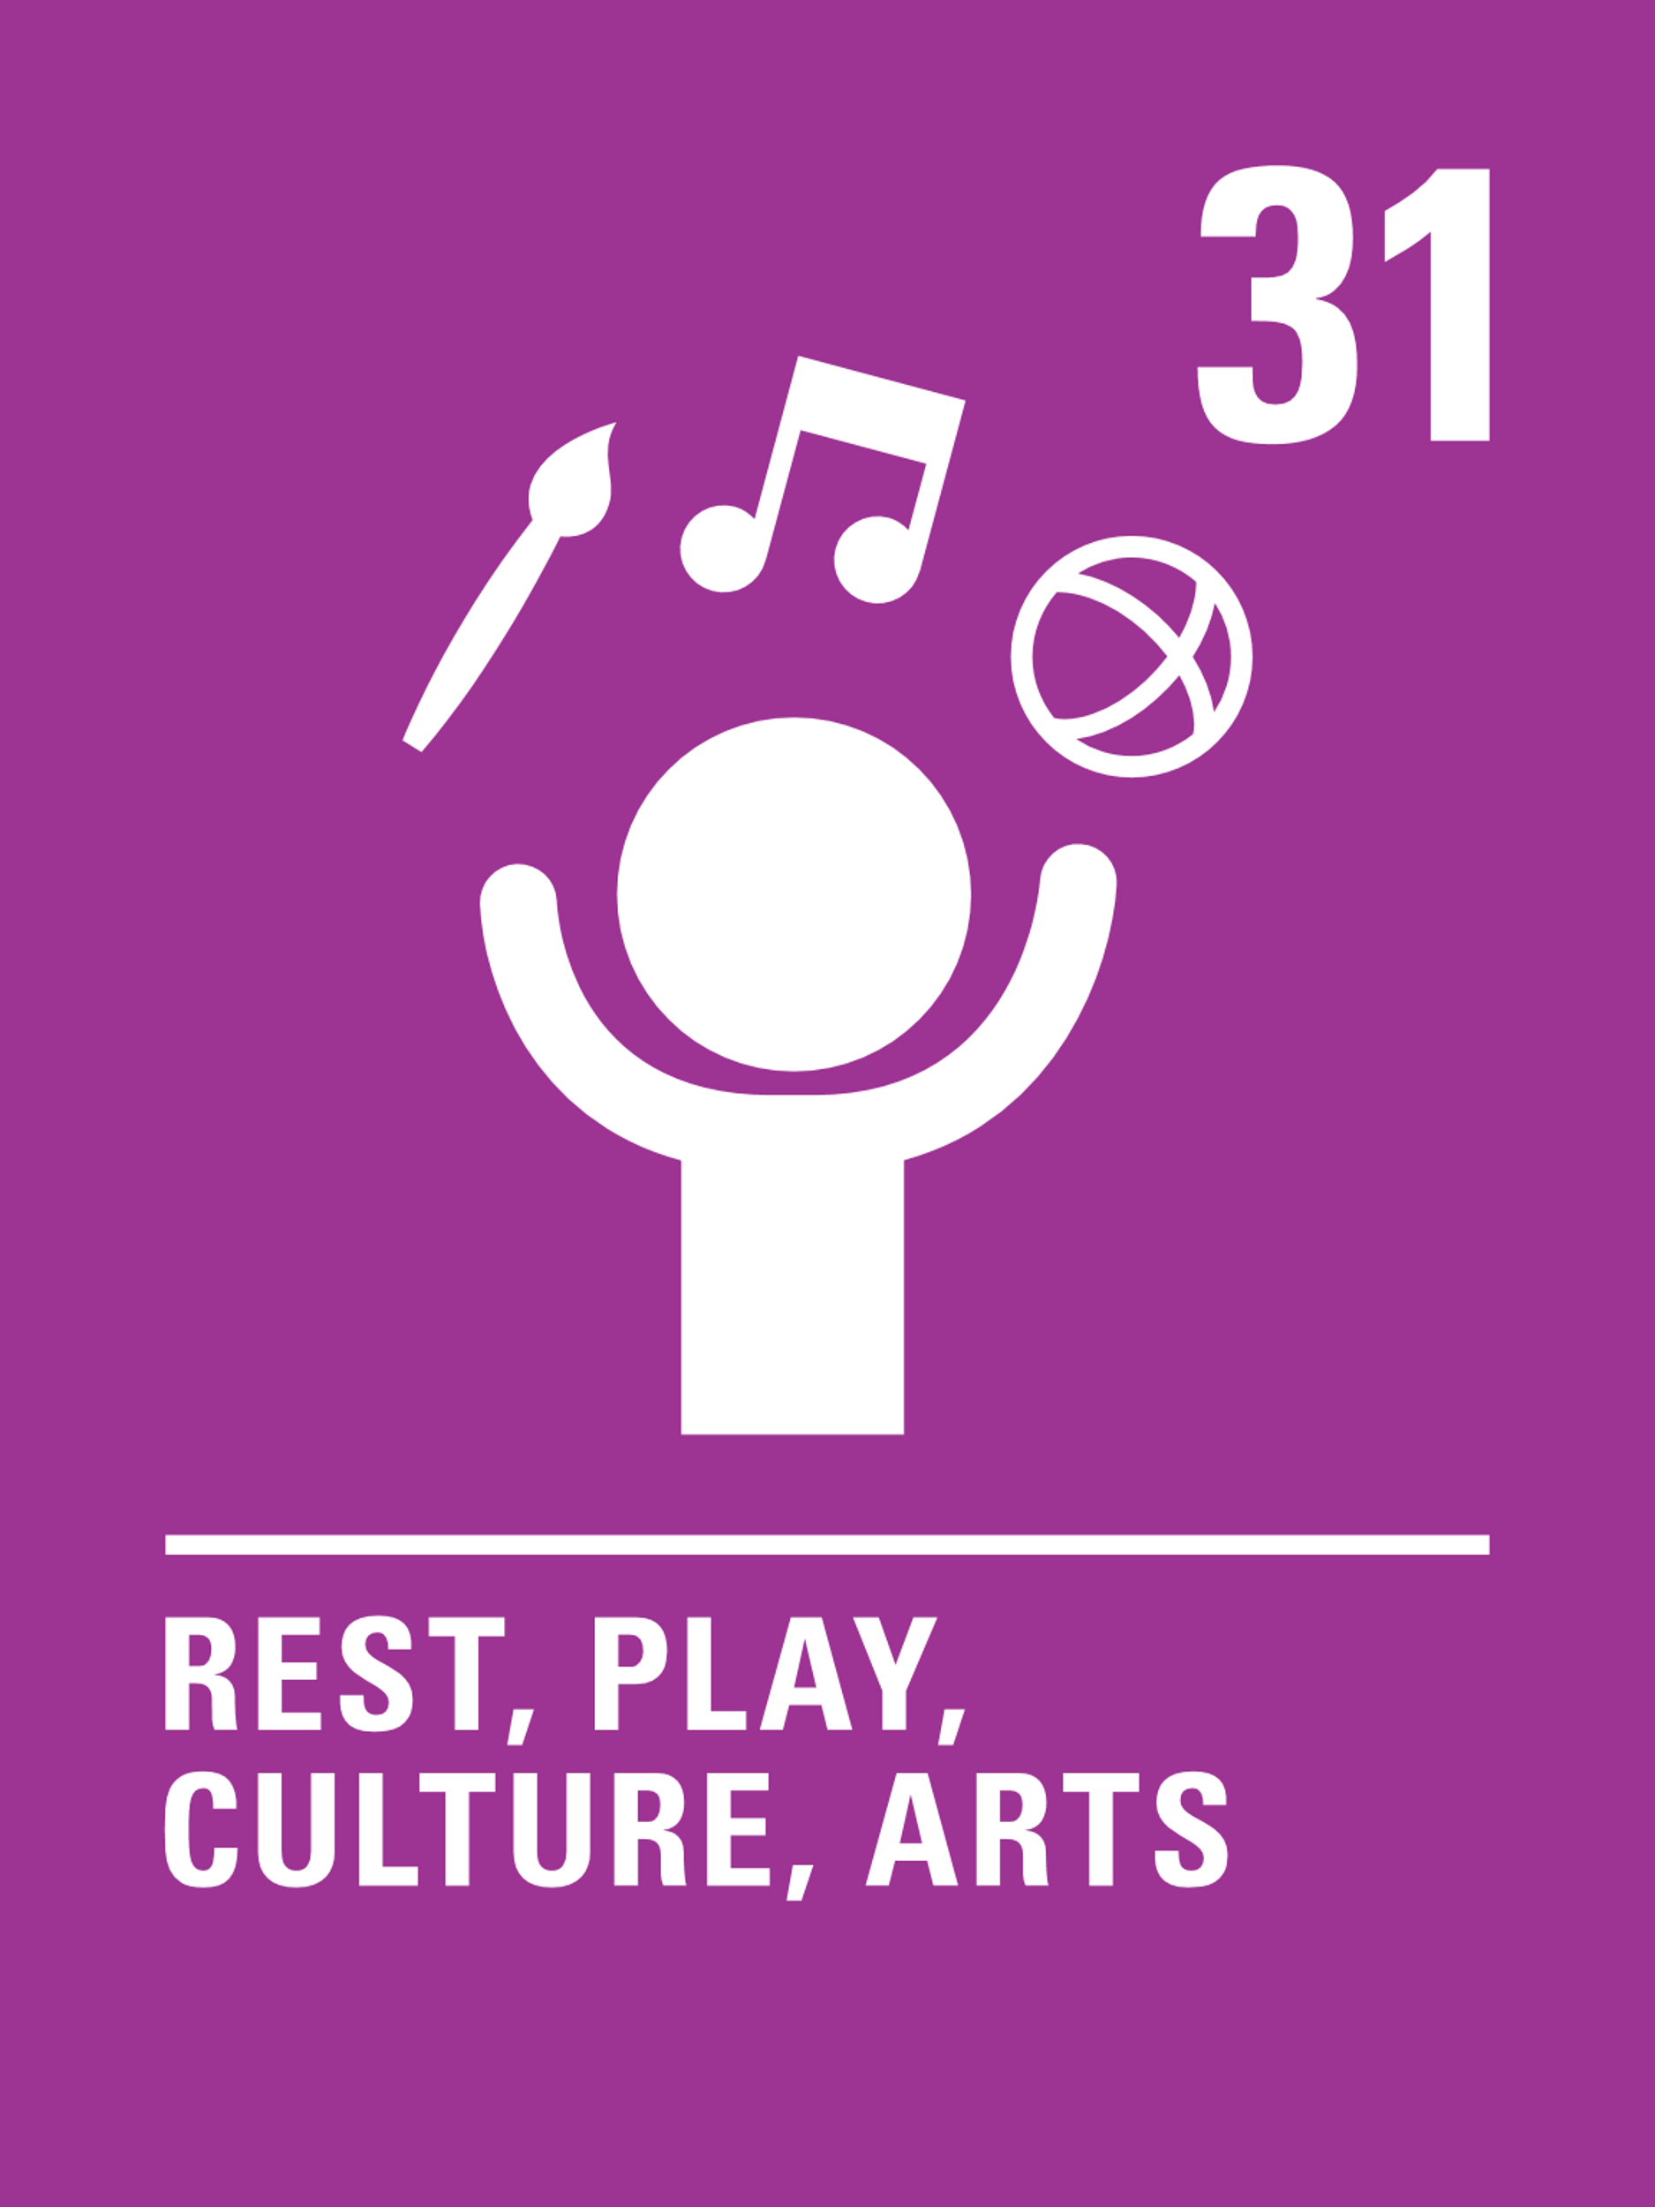
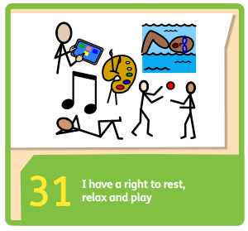

Article 31
Every child has the right to relax, play and take part in a wide range of cultural activities.

Slide 6

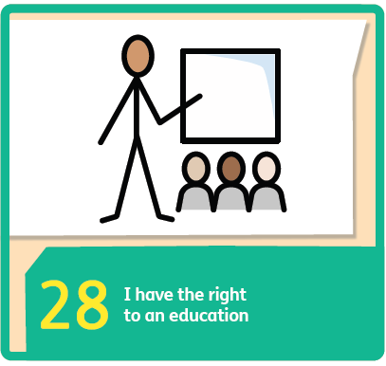
Article 28
Every child has the right to an education.

Slide 7
Barriers to accessing the right to play and learn
What might stop children around the world from enjoying their right to play and learn?
Notes:
Teacher notes: Talk to your partner. Ask pupils who would like to share their ideas.

Slide 8
Did you think of these?
  Disability or impairment
  War
  Having to go to work
  Poverty
  Discrimination
  Punishment
  Adults not allowing them to
  Climate change and natural disasters
  Worrying about safety
  Where you live - being isolated / lack of access
  Ill health / lack of access to healthcare
  Absence of safe spaces to play
Notes:
Teacher notes: Discuss each of these points in more detail if not yet covered.

Slide 9
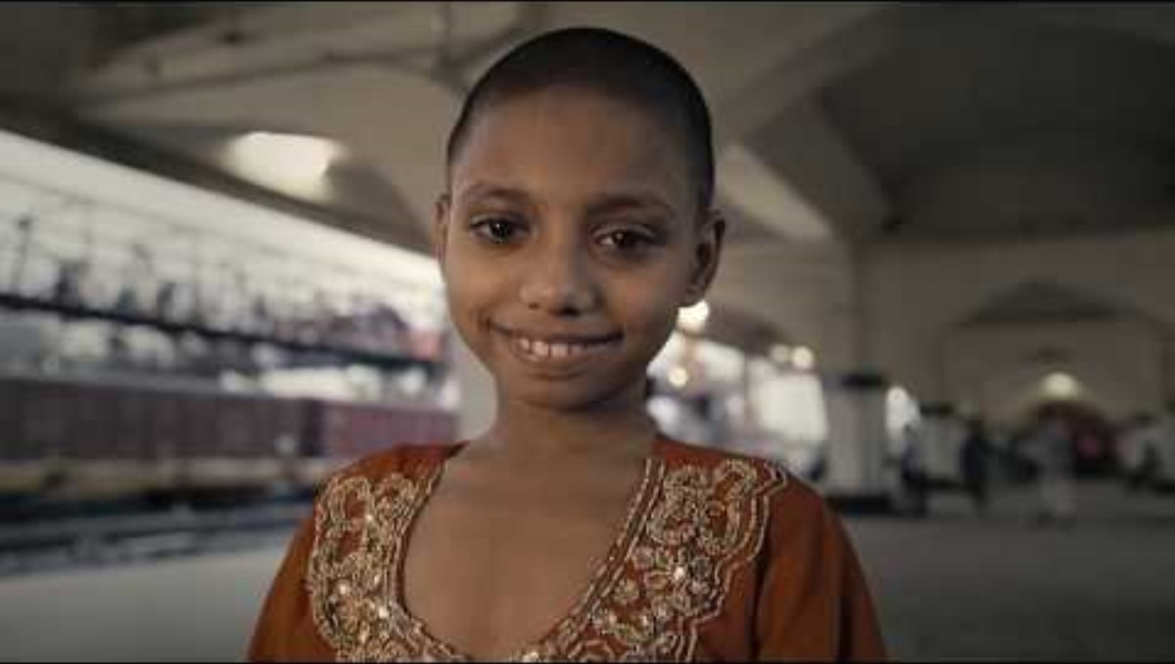
HOW DOES UNICEF PROTECT CHILDREN’S RIGHTS GLOBALLY?
UNICEF is the only organisation working for children recognised in the text of the Convention.
For over 75 years, UNICEF has protected childhood by ensuring more of the world’s children are vaccinated, educated, and protected than any other organisation.
In emergencies, UNICEF works with partners to deploy a number of relief measures, like rushing medicines and other emergency supplies to impacted areas, vaccinating people to prevent disease outbreaks and making sure there's enough safe water.
Notes:
Teacher notes:
Find out more here https://www.unicef.org.uk/what-we-do/

Slide 10
Child-Friendly Spaces
Emergencies are disorienting and traumatizing, especially for children. Providing opportunities for children to gather in a safe space and play with other children — away from the danger and chaos of conflict or other crises — offers much needed protection and comfort.
Notes:
Teacher notes:
Another key component of the UNICEF emergency response is the child-friendly space. The purpose of a child-friendly space is to allow children who are caught in a crisis to gather in a safe environment, play with their peers and access their rights, including the right to learn. A child-friendly space is also where at-risk children and families can go to get health care, counselling and other services, including protection from violence, exploitation and abuse.
Reference: https://www.unicefusa.org/what-unicef-does/emergency-response/child-friendly-spaces

Slide 11
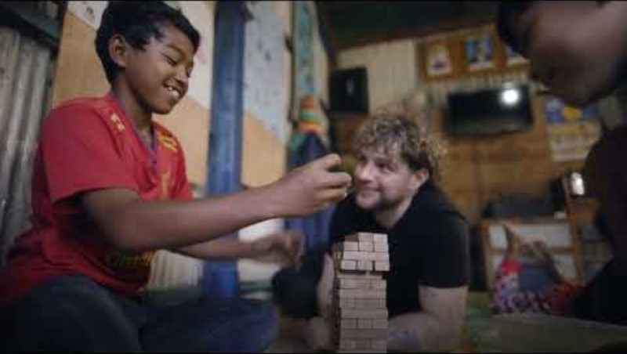
CHILD FRIENDLY ​SPACES IN CAMBODIA
Notes:
Teacher notes: Last year, Tom Grennan travelled to Cambodia to see first-hand how UNICEF are supporting children in Phnom Penh. ​
Tom met 14-year-old Theara, who lives with his family in an area that poses many dangers to children — none more so than the live railway line that runs through the middle of the community. ​
Tom visited UNICEF-funded safe spaces that help children like Theara to access education and simply to play, out of harm's way.
Play video. WARNING: Video may be upsetting for some children, please review before showing to your group.
Discuss: How did the film make you feel?
List the rights that the children in the video aren’t accessing.
What could be done to change this?

Slide 12
CHILD FRIENDLY ​SPACES IN CAMBODIA
“Soccer Aid has always been close to my heart, but being asked to see where the money that is raised goes has completely shifted my whole view on what Soccer Aid is about. UNICEF have helped to create this community centre and this safe place for children to learn and play, to just be kids. I’m proud to be a part of it.”
- Tom Grennan​

Slide 13
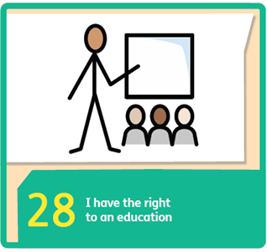
CHILD-FRIENDLY SPACES
AS CLASSROOMS
In a crisis, children are often cut off from school; getting out-of-school children back to learning is always a top priority, so a UNICEF child-friendly space will often double as a temporary classroom or an informal learning space. To be able to get back into a regular routine alongside peers is a great way to counter feelings of fear or uncertainty. And while children are busy learning and playing, parents and caregivers get a chance to rest, knowing their children are safe.
Notes:
Teacher notes: Let’s have a look at some UNICEF child-friendly spaces around the world….
Reference: https://www.unicefusa.org/what-unicef-does/emergency-response/child-friendly-spaces

Slide 14
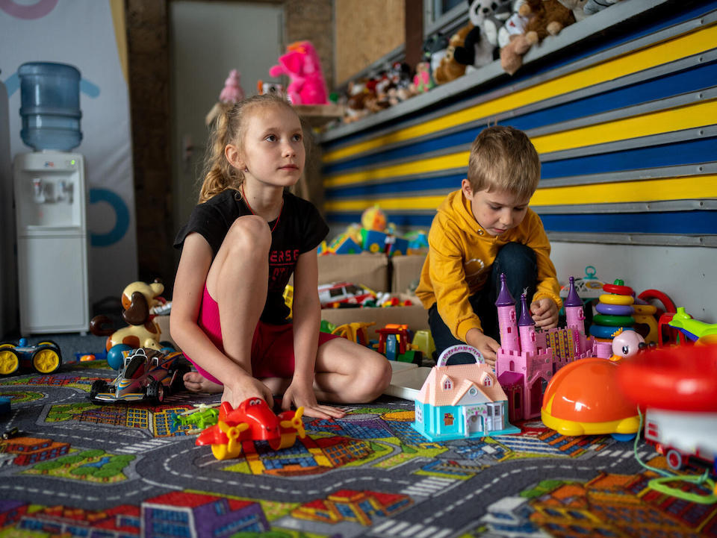
UKRAINE
© UNICEF/Filippov
Notes:
Teacher notes: UNICEF helped set up and continues to staff Child-Friendly Spaces across Ukraine to assist children and families impacted by the war. In this photo, two children play at a Child-Friendly Space located inside a railway station in Mykolaiv.
Reference: https://www.unicefusa.org/what-unicef-does/emergency-response/child-friendly-spaces

Slide 15
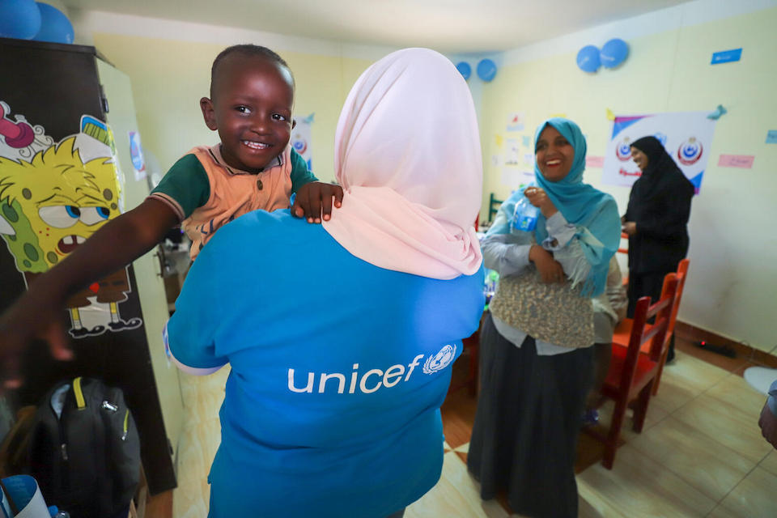
EGYPT
© UNICEF/Mostafa
Notes:
Teacher notes: As conflict spread across Sudan in April 2023, UNICEF worked quickly with its partners to open a Child-Friendly Space inside the Karkar bus station near Aswan, southern Egypt, to support children and families who were fleeing across borders to escape the danger.​​​​​​ Within a few weeks of its opening, the centre had served over 2,000 children.
Reference: https://www.unicefusa.org/what-unicef-does/emergency-response/child-friendly-spaces

Slide 16
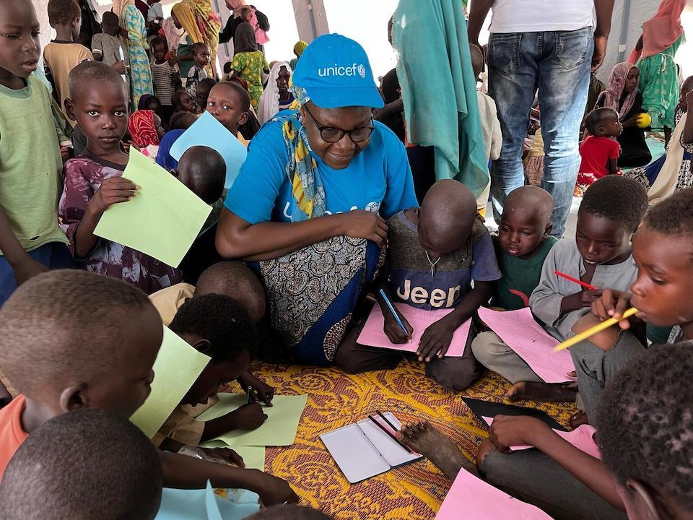
CHAD
© UNICEF/Le Du
Notes:
Teachers notes: While some Sudanese refugees fled to Egypt, others fled to Chad. In this photo, a UNICEF child protection officer joins young refugees from Sudan for a group activity inside a child-friendly space at a camp in Farchana, Chad.
Reference: https://www.unicefusa.org/what-unicef-does/emergency-response/child-friendly-spaces

Slide 17
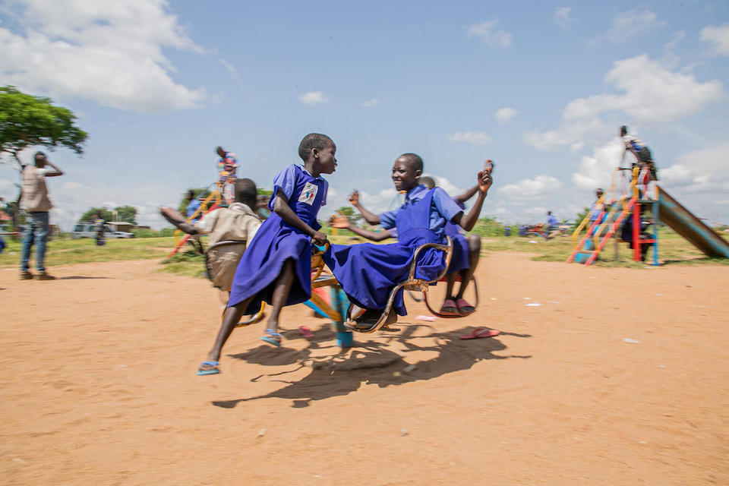
UGANDA
© UNICEF/Abdul
Notes:
Teacher notes: Child-friendly spaces often operate outdoors. In this photo, refugees from South Sudan play outside the Bongilo Early Childhood Development Center in Obongi District, Uganda, where at-risk children and their families — including those from the host community — can access support services and group activities. The facility is part of a broader government-led program aimed at strengthening child protection for all children in the country.
Reference: https://www.unicefusa.org/what-unicef-does/emergency-response/child-friendly-spaces

Slide 18
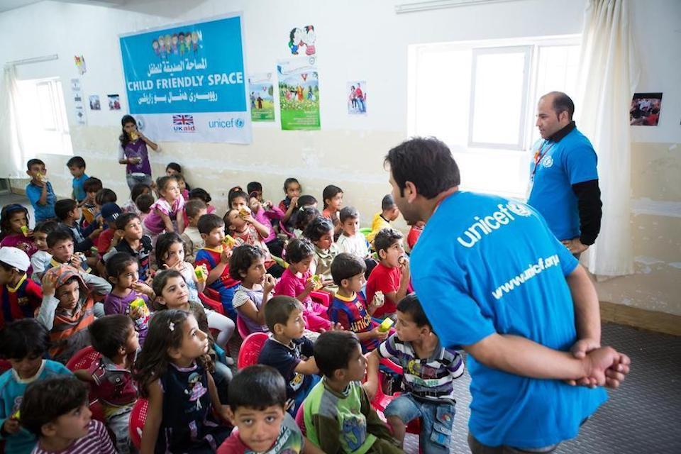
IRAQ
© UNICEF/Schermbrucker
Notes:
Teacher notes: In this photo, a UNICEF staff member engages children at a tented child-friendly space at the Domiz refugee camp in northern Iraq, home to refugees fleeing the war in Syria. Having a chance to interact with peers in a safe space helps children start to recover from trauma.
Reference: https://www.unicefusa.org/what-unicef-does/emergency-response/child-friendly-spaces

Slide 19
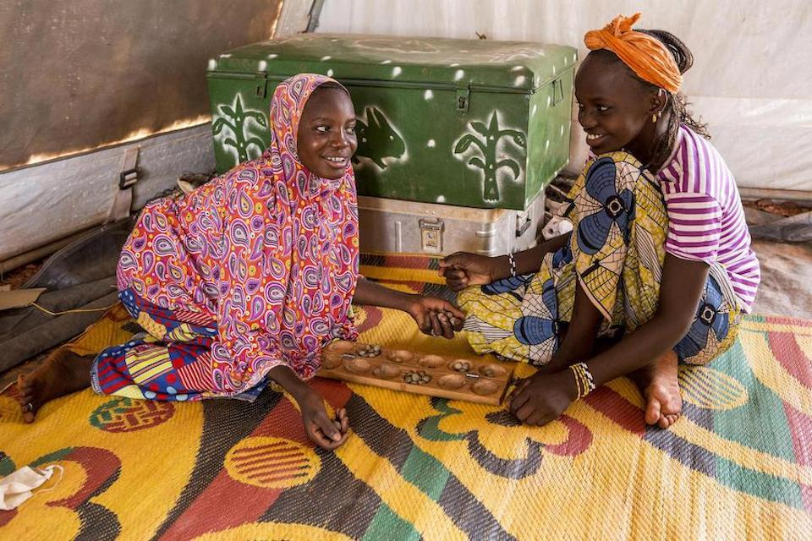
MALI
© UNICEF/Keïta
Notes:
Teacher notes: In this photo, two friends play a traditional game at the UNICEF-supported child-friendly space at the Socoura camp for displaced families in Mopti, central Mali.
Reference: https://www.unicefusa.org/what-unicef-does/emergency-response/child-friendly-spaces

Slide 20
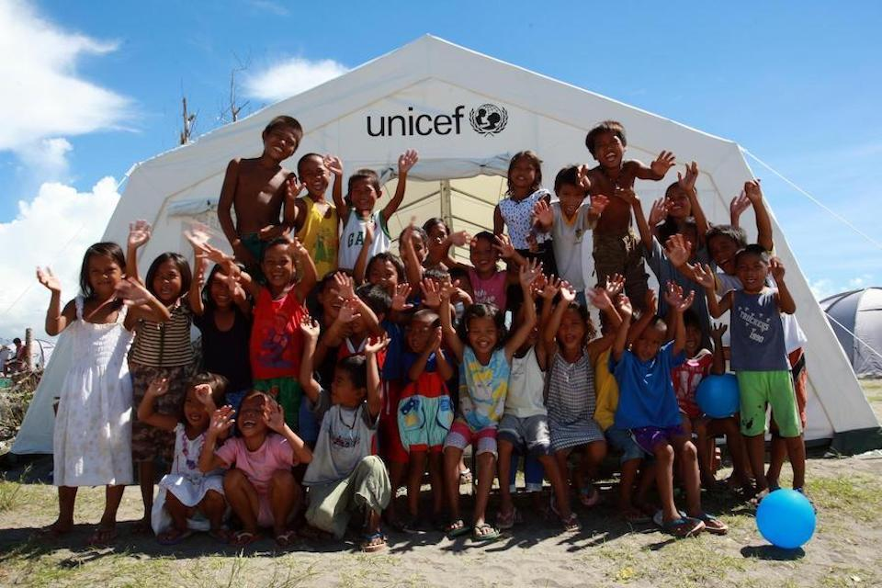
PHILIPPINES
© UNICEF/Maitem
Notes:
Teacher notes: In this photo, children gather outside a tent serving as a UNICEF-supported child-friendly space in the town of Tanauan, in the Philippines — one of the areas hit hardest by Typhoon Haiyan. Creating safe spaces for children whose homes and schools were damaged in the storm was a key part of UNICEF's emergency response, which also included delivering clean water and hygiene kits, screening children for malnutrition and reunifying children who had become separated from their families.
Reference: https://www.unicefusa.org/what-unicef-does/emergency-response/child-friendly-spaces

Slide 21
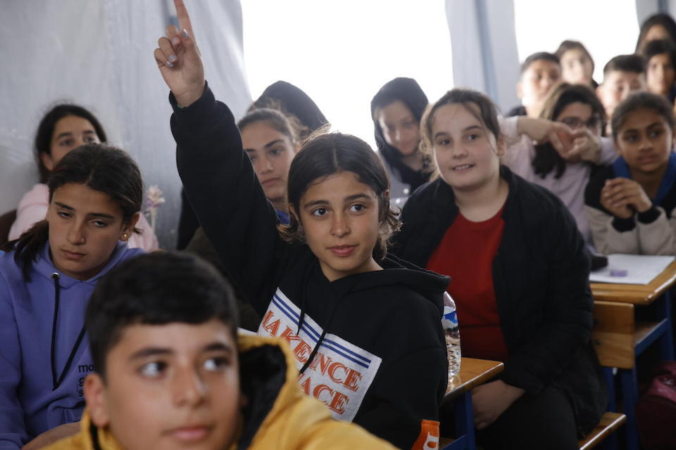
TÜRKIYE
© UNICEF/Karacan
Notes:
Teacher notes: After a massive earthquake devastated parts of Türkiye and Syria in February 2023, UNICEF quickly created child-friendly spaces next to temporary housing for families who had lost everything. In this photo, students living at a camp for displaced families attend class under a tent. When disasters strike, providing ways for children to continue their education is always a UNICEF priority.
Reference: https://www.unicefusa.org/what-unicef-does/emergency-response/child-friendly-spaces

Slide 22
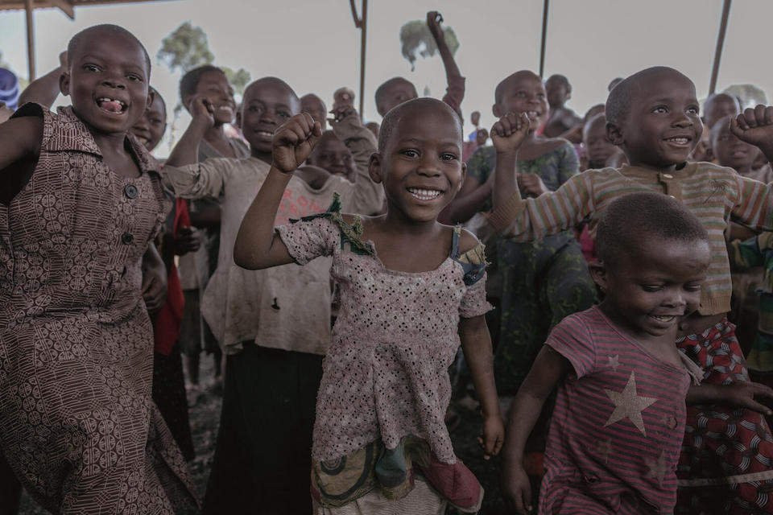
DEMOCRATIC REPUBLIC OF CONGO
© UNICEF/Ndebo
Notes:
Teacher notes: This photo shows children playing in a child-friendly space set up by UNICEF and partners at the Rusayo camp, in DRC. The space is one of over twelve that have been established across eight different camps in the area to help at-risk families impacted by armed conflicts. UNICEF-supported staff are there to help trace parents of unaccompanied or separated children and provide support.
Reference: https://www.unicefusa.org/what-unicef-does/emergency-response/child-friendly-spaces

Slide 23
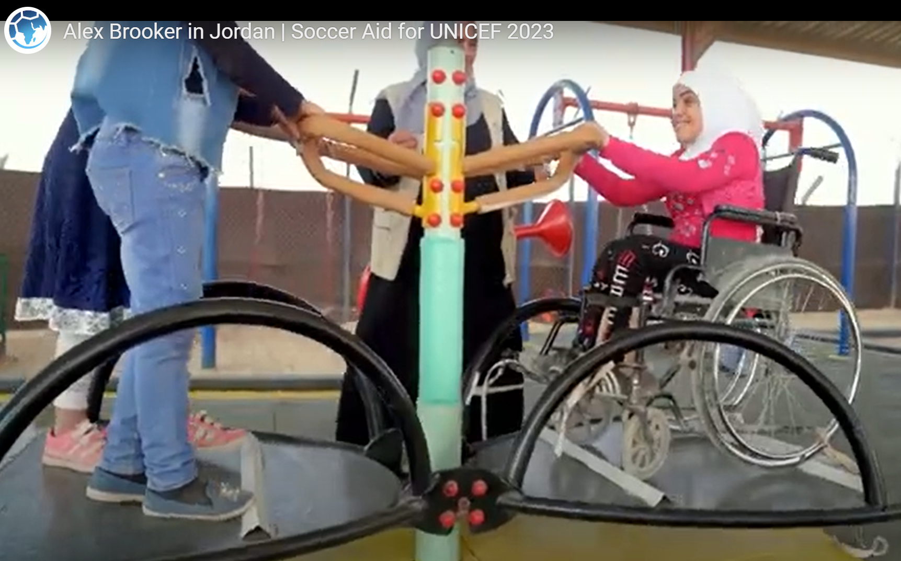
JORDAN
Notes:
In 2023 as part of Soccer Aid, Alex Brooker travelled to Za’atari Refugee Camp, Jordan, where he met Elan. Elan and her family are Syrian refugees who, alongside 80,000 other people, call Za’atari their home .In Za’atari, Alex visited a UNICEF supported inclusive playground for children – the first playground of its kind anywhere in the world. There, all children are able to play with their friends, thanks to seesaws and merry-go-rounds with space for wheelchairs, accessible swings for children who struggle with grip, and a sandpit, trampoline and beanbag especially designed for children with Autism.
Reference: https://www.unicef.org.uk/celebrity-supporters/alex-brooker-unicef-uk-high-profile-supporter/

Slide 24



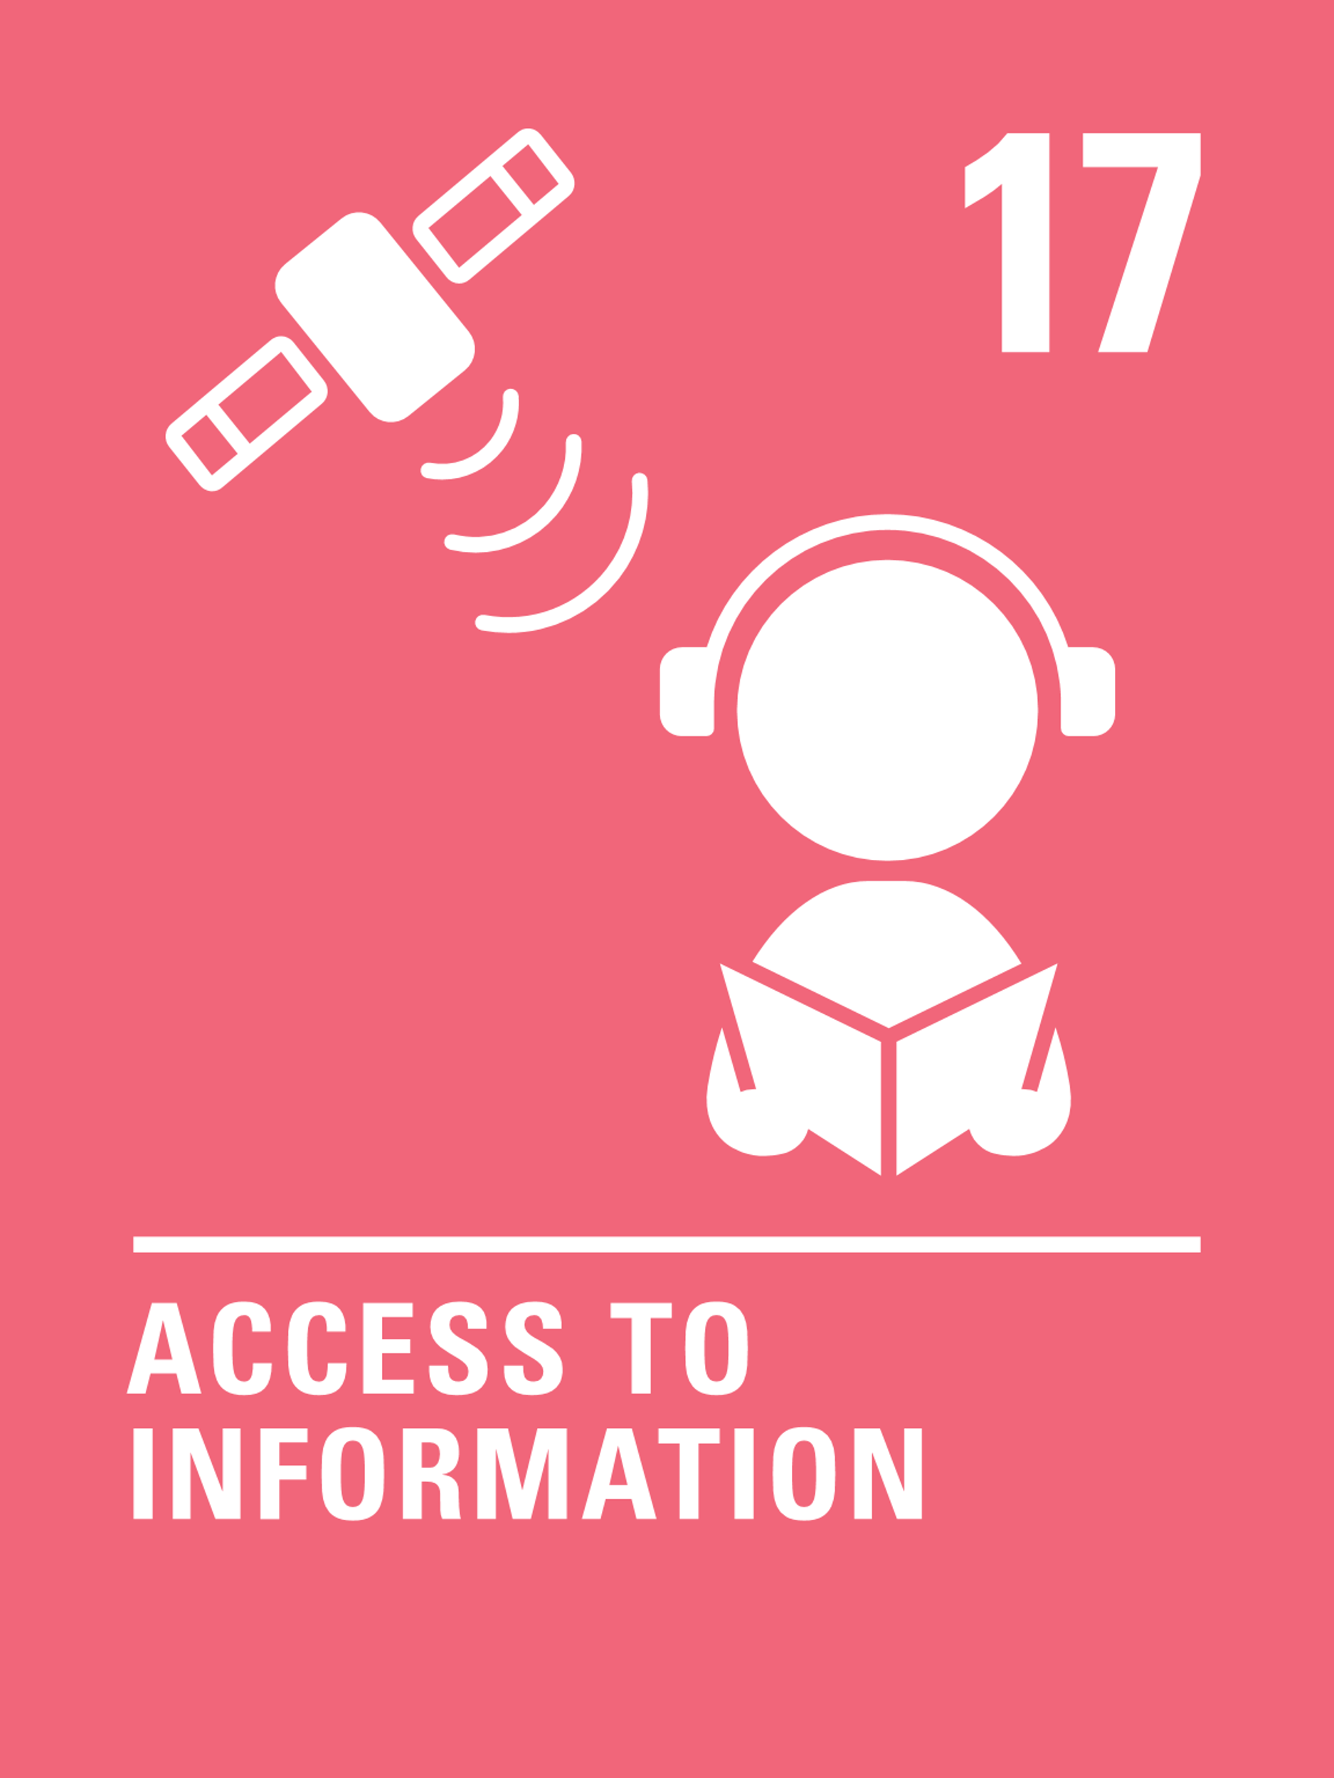


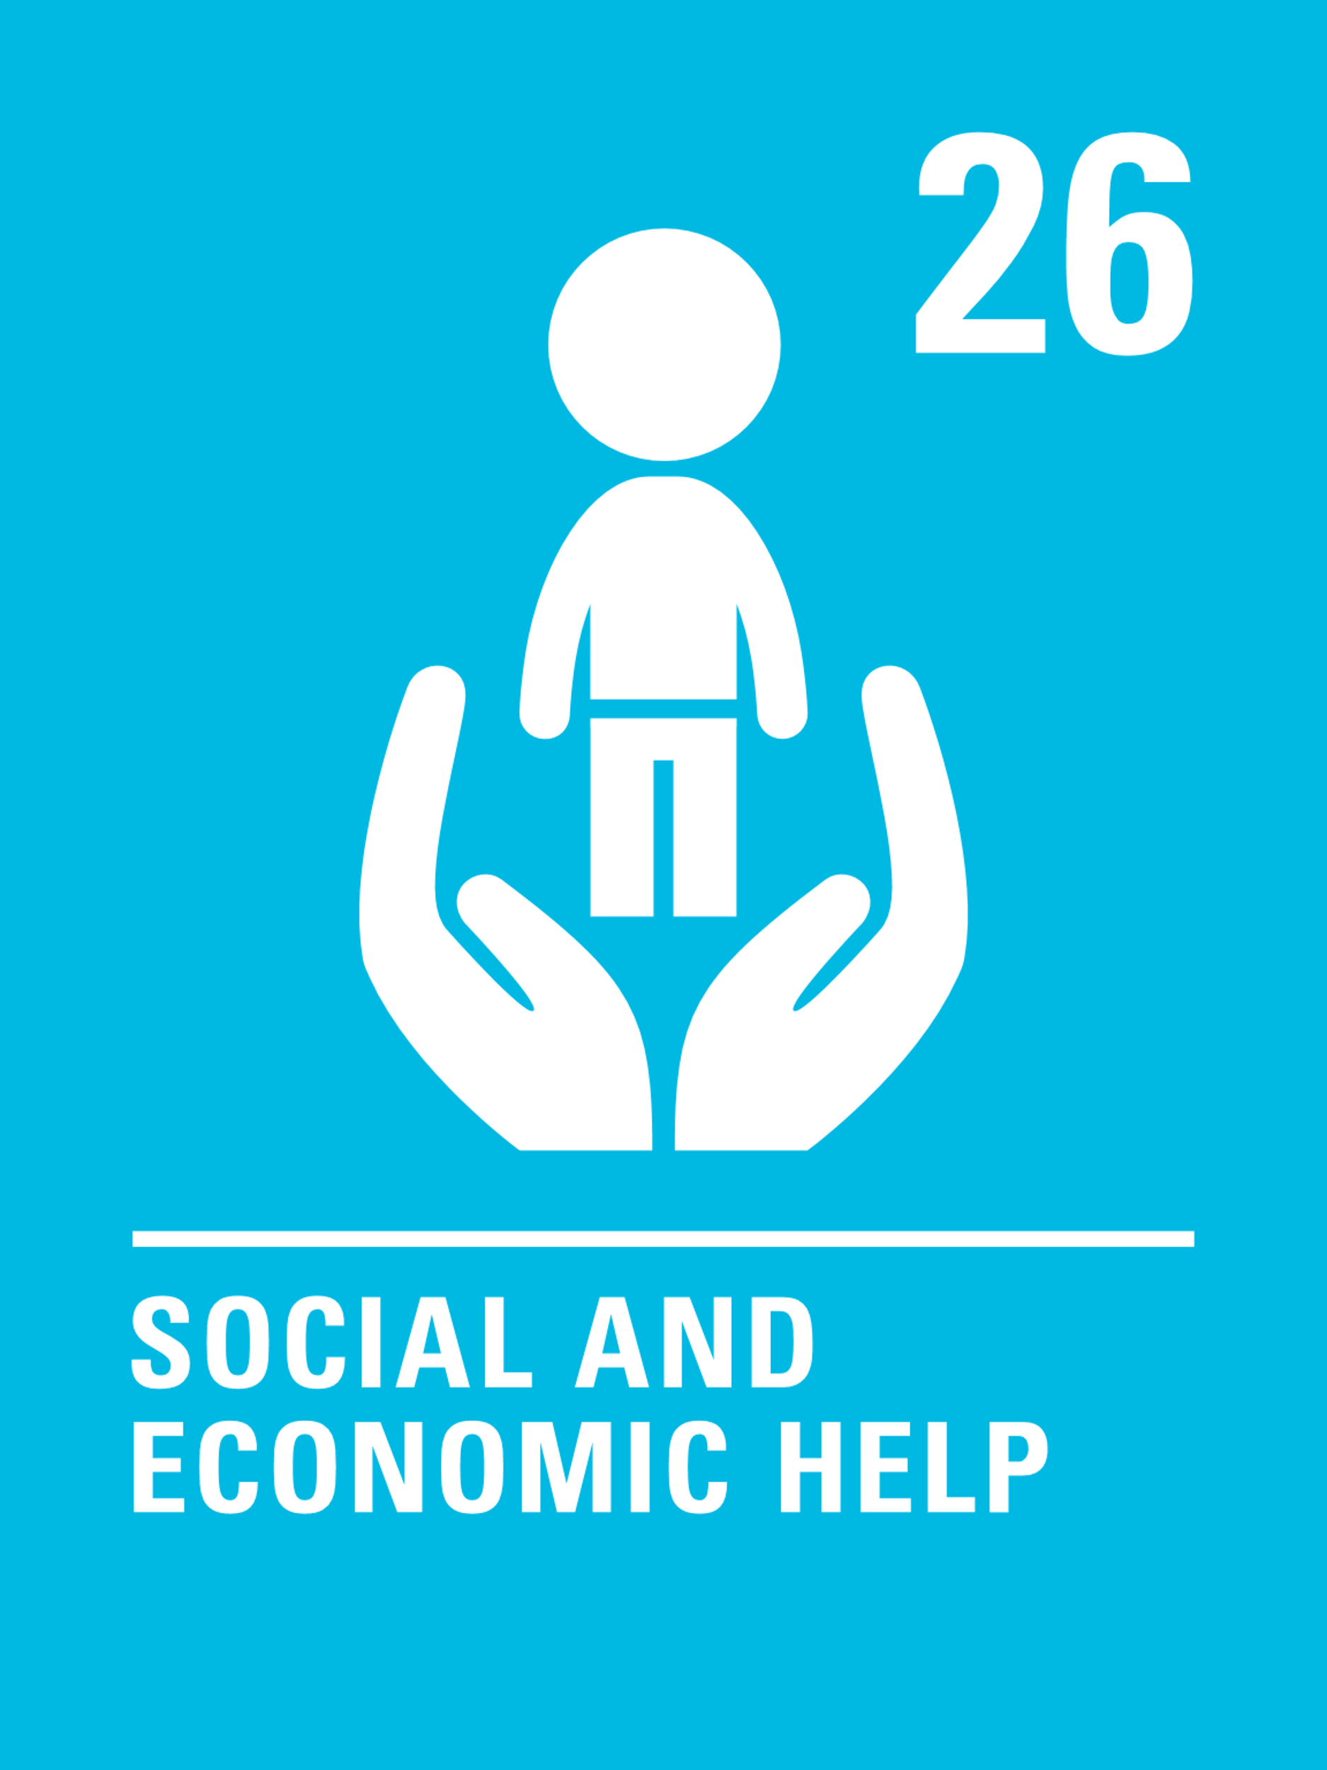


Activity: to design a
Child Friendly Space (CFS)
for our local community or school
Your child friendly space should allow all children to access these rights in safety:
Notes:
Teacher notes: Design a child friendly space for your local community or school, where all children would be safe to learn.
Students design what a safe child friendly space in the community or school would look like to them, by drawing, collage or (depending on resources) sculpting with recycled materials.
Your child friendly space should allow children to access their rights to…. [Go through articles and ensure children understand what these mean]

Slide 25
Design a
Child Friendly Space (CFS)
for our local community or school
What would make the spaces around you more friendly and safe? Think about:
What would a safe place to learn look like?
What would it include?
What would it smell like?
What colours would it be?
How light would the space be?
What sort of people would be there?
What sort of things would not be there?
(for example, broken glass, unlit areas or unclean things)
Notes:
Teacher notes:
Prompt questions:
What would a safe place to learn look like around our school?
What would it include?
What would it smell like?
What colours would it be?
How light would the space be?
What sort of people would be there?
What sort of things would not be there? (for example, broken glass, unlit areas or unclean things)

Slide 26
Inclusion
How can you make sure all children can access their rights to learn and play in your child friendly space?
Notes:
Does anyone know what the word inclusion means?
What does the word sound like? Does it sound like any other words you know? INCLUDE!
Inclusion means to include everyone and leave no one out.
Sometimes we need to remove barriers to make sure everyone is included.

Slide 27


Design an inclusive child friendly space (CFS)
Success Criteria:
Your CFS should be safe.
Your CFS should include everyone.
Your CFS should be accessible for children with physical disabilities, including wheelchair users and visually impaired children.
Your CFS should be calm and feel safe and welcoming.
There should be ways for everyone to communicate and play with each other.

Slide 28
Helping others to enjoy the
right to play and learn in safety
Create a “paperchain of promises” to help each other enjoy the right to be safe to learn.
Notes:
Teacher notes: Create a paperchain of promises using strips of paper that children have written/drawn on identifying how they will help themselves and others to stay safe and enjoy their right to learn.
Examples might include: “I will tell the teacher if I don’t feel safe”; “I will make friends with someone who is sad or lonely”; “If I feel angry with someone, I won’t hit or hurt them” etc.

Slide 29
GETTING HELP
If you have any concerns about anything we have covered in the session, please reach out:
INSERT FACILITATOR OR TEACHER NAME
INSERT SCHOOL DESIGNATED SAFEGUARDINGN LEAD
www.childline.org.uk
youngminds.org.uk
nspcc.org.uk
Notes:
Teacher notes: customise this slide If children were upset by any of the issues raised today then can access support by…

