Slide 1
SOCCER AID FOR UNICEF ACADEMY 2025

Slide 2
THE RIGHT TO PLAY AND
IMPACT ON WELLBEING

Slide 3
AIMS:
To understand the importance of children’s rights
To identify why play is important in my own life and why it is a right we need to protect
To discuss the importance of play in the lives of all children around the world

Slide 4

Notes:
Teacher notes:
Children 5 - 7 Script:
The United Nations Convention on the Rights of the Child (CRC) is the basis of all UNICEF’s work. The CRC sets out the human rights of every person under the age of 18. The Convention has 54 articles that cover all aspects of a child’s life and set out the rights that all children everywhere are entitled to. It also explains how adults and governments must work together to make sure all children can enjoy all their rights. Every child has rights, whatever their ethnicity, gender, religion, language, abilities or any other status. The Convention must be understood as a whole: all rights are linked and no right is more important than another. The right to relax and play (article 31) and the right to freedom of expression (article 13) are as important as the right to be safe from violence (article 19) and the right to education (article 28).
Children 7 - 11 Script:
The United Nations Convention on the Rights of the Child (CRC) is the basis of all UNICEF’s work. The CRC sets out the human rights of every person under the age of 18. It was adopted by the UN General Assembly in 1989 and is the most widely agreed international human rights treaty in history. The UK signed the convention on 19 April 1990, ratified it on 16 December 1991 and it came into force on 15 January 1992. The Convention has 54 articles that cover all aspects of a child’s life and set out the rights that all children everywhere are entitled to. It also explains how adults and governments must work together to make sure all children can enjoy all their rights. Every child has rights, whatever their ethnicity, gender, religion, language, abilities or any other status. The Convention must be understood as a whole: all rights are linked and no right is more important than another. The right to relax and play (article 31) and the right to freedom of expression (article 13) are as important as the right to be safe from violence (article 19) and the right to education (article 28).

Slide 5
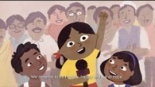
WHAT IS THE CONVENTION ON THE RIGHTS OF THE CHILD (CRC)?
Notes:
Teacher notes:
Watch this video online: https://youtu.be/HCYLdtug8sk?si=Qx-kAkN5AFY8wCiI
OPTIONAL ACTIVITY:
Either:
Play Kahoot children’s rights quiz: https://create.kahoot.it/details/5e6d6fba-65a0-40f7-9775-4ef7633c2f4f
Or:
Play one of the children’s rights cards games using these CRC symbol cards.

Slide 6
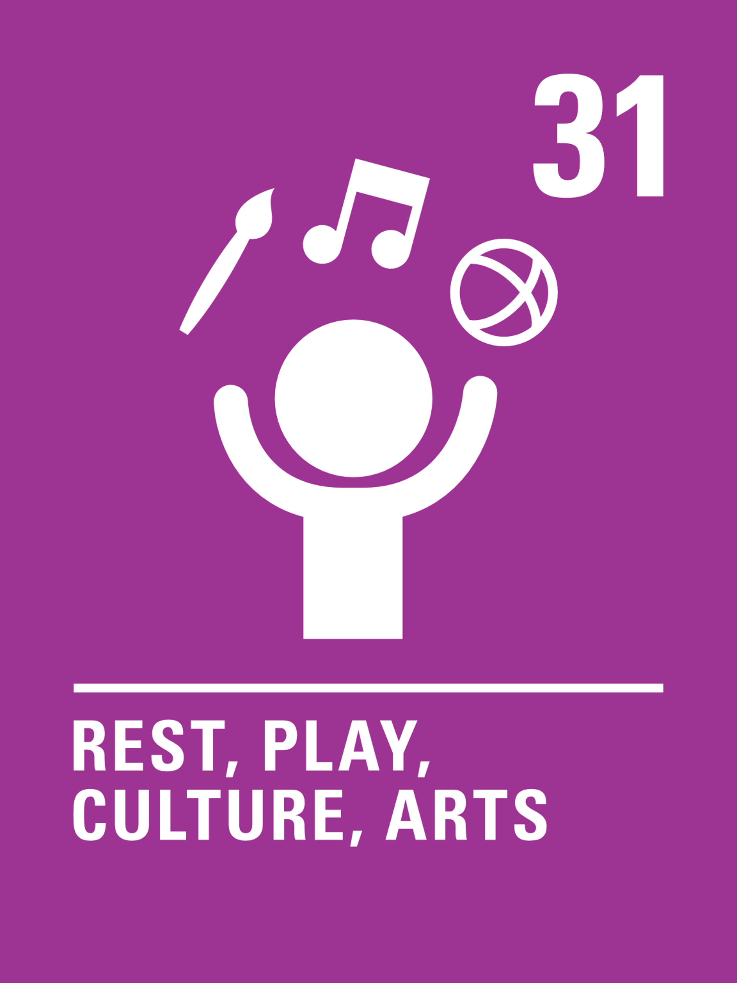
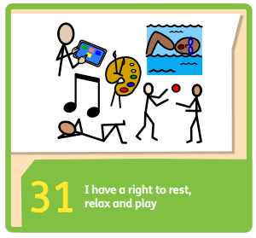

Introducing Article 31
Every child has the right to relax, play and take part in a wide range of cultural activities.
Notes:
Teachers notes: A full and summary version of the UN Convention on the Rights of the Child can be found here - https://www.unicef.org.uk/what-we-do/un-convention-child-rights/

Slide 7
Article 31 – a question
In what different ways have you enjoyed Article 31 during the last school year?
Notes:
Teacher notes:
Talk to your partner.
Feedback.
Optional: Record answers to create a personalised class poster of Article 31.

Slide 8
Did you think of these?
  Arts and craft activities.
  Chilling out.
  Spending time with friends.
  Learning and practising another language.
  Going to a museum or gallery.
  Going to the theatre, to concerts or to the cinema.
  Taking part in sport.
  Having a safe space to, relax, read, draw or listen to music.
  Playing at the park.
  Playing computer games.
  Doing yoga, meditation or mindfulness activities.
  Sleeping!

Slide 9
PARTNER TALK
Why is play important to you?
Notes:
Teacher notes: Feedback as class. Ask who would like to share what they discussed.
OPTIONAL: Record children’s answers to create a personalised class poster of Article 31.

Slide 10
PARTNER TALK
How do you help each other enjoy your right to play
in school?
Notes:
Teacher notes: Feedback as class. Ask who would like to share what they discussed.
OPTIONAL: Record children’s answers to create a personalised class poster of Article 31.

Slide 11
ACTIVITIES
You do not need to complete every activity but if you have time, you can try to complete more than one.
How do you like to spend your free time? Think about what your ideal weekend would be like. Where would you go? What would you do? What activities would you participate in? What rights would you enjoy? Create a comic strip showing your dream weekend and share it with your class.
Let Toys be Toys is a campaign that wants to stop people viewing some toys as for boys and other for girls. Do you think it matters? Debate this as a class. Design a new toy for everyone in the class to play with.
Make an ‘Article 31
chill-out den’ in your classroom or playground where you can relax. Use cushions, blankets and even fairy lights. Take a picture of yourself relaxing in your chill-out den and share it with your school community.
Imagine your headteacher is going to ban the school holidays. Write a persuasive letter to them explaining why you think having a break from school is so important.
Make a list of the clubs your school runs at lunchtimes and after school. Is there something for everyone? Do you have a great idea for a new club? Think about how you could share your views about clubs at your school.
Create a display of drawings/artwork of everyone enjoying their favourite way of playing.
Notes:
Teacher or pupils to decide which one activity to complete.

Slide 12
The importance of play in the lives of
all children around the world
All children around the world have the right to play, but they might play some different games than the ones you’re used to. Take a look at some of these Traditional Games from around the world and have a go at playing with your friends.
Notes:
Teacher notes: Choose which of the games you would like the children to play and prepare resources in advance.

Slide 13
Reflection
Think about how you will make sure that you enjoy your right to rest, play and take part in cultural activities.
How will you respect and help
to protect other children’s right
to play?

