Slide 1


SOCCER AID FOR UNICEF ACADEMY 2025
Notes:
This assembly is designed to help you introduce the Soccer Aid for UNICEF Academy in your school. These slides can be tailored to fit your plans and school context.

Slide 2
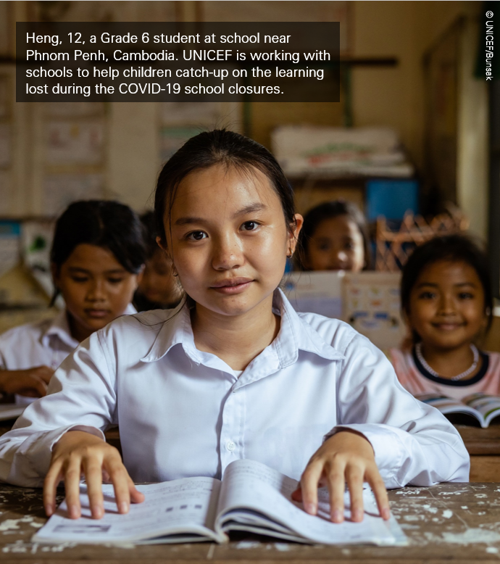
Who are UNICEF?
UNICEF is the world's leading children's organisation.
UNICEF is an agency of the United Nations – meaning that their work is impartial and non-political
They work to improve the rights of children providing humanitarian and developmental aid to children worldwide, particularly the most vulnerable.
Notes:
UNICEF is the world's leading children's organisation.
Why? Because UNICEF works in the world’s toughest places to reach the most vulnerable children, protecting the rights of every child, everywhere. To do that, they work in more than 190 countries worldwide.
UNICEF is an agency of the United Nations, meaning that the work UNICEF does is impartial and non-political. So, regardless of the nationality, race or religion, UNICEF works to ensure the rights of all children everywhere.
UNICEF is mandated to advance the rights of children. This is set out in the UN Conventions of the Rights of the Child. To advance the rights of children, UNICEF works with all the various United Nations agencies and funds to make sure that children are on the global agenda, especially the most vulnerable.

Slide 3



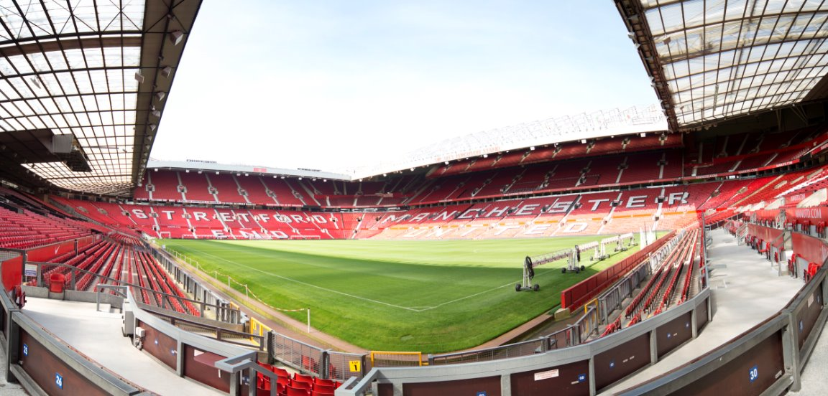
SOCCER AID FOR UNICEF 2025
vs
Sunday 15 June
Old Trafford
ITV1, ITVX, STV and STV Player
Notes:
Soccer Aid is a football match that raises money for UNICEF. It is played between England and the World XI (eleven). The teams are made up of some of the football’s biggest legends like Wayne Rooney, Jill Scott and Jermaine Defoe, and celebrities from across the world like Louis Tomlinson, Sam Quek and Tom Grennan.
And it’s the only FA-sanctioned mixed gender match!
This year’s Soccer Aid match is being held at Old Trafford – Manchester United's stadium.
It’s on Sunday 9th June and it kicks off at 7:30pm, and will be live on TV on ITV1 and STV.

Slide 4

WHAT IS THE SOCCER
AID FOR UNICEF ACADEMY?
Our school is signed up to take part in three challenges; focusing on sporting skills, creativity and teamwork.
We’ll be getting active, fundraising and learning about UNICEF’s work around the world.
Let's find out more from Livi Sheldon AKA Diamond, Gladiator...
Notes:
So what is the Soccer Aid for UNICEF Academy?
This is where schools up and down the country take part and raise money for Soccer Aid for UNICEF. And we’re on the team!
We will be taking part in three challenges, focusing on sporting skills, creativity and teamwork.
We'll also be learning about children's rights and the work of UNICEF around the world.
Most importantly, we're going to be raising money to support Soccer Aid for UNICEF, making a difference to children around the world.
Intro video from Diamond on next slide.

Slide 5
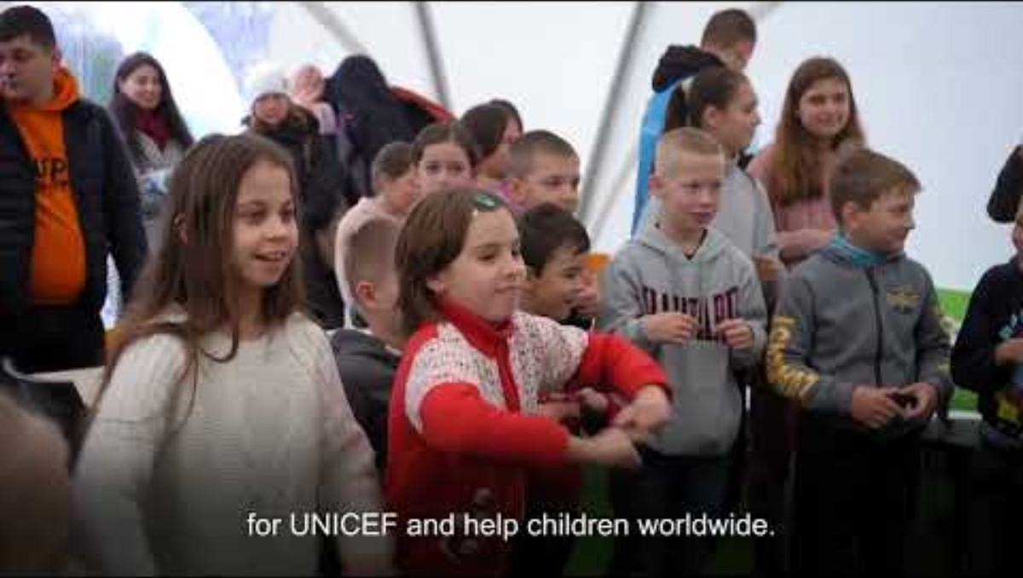
Notes:
Play video: Welcome to the Soccer Aid for UNICEF Academy - YouTube

Slide 6
WE WANT TO MAKE SOCCER AID FOR UNICEF 2025 OUR BEST YEAR YET…
2024
£15m
2023
£14.6m
2022
£15.6m
2021
£13m
2020
£9.3m
2019
£7.9m
and we need YOUR help!
Notes:
By being part of Soccer Aid for UNICEF we are joining one big team – united by a goal to help protect play for children everywhere so they can grow up happy, healthy, and ready to take on the world.
Since the first Soccer Aid in 2006, over £106m has been raised for UNICEF to support their work all over the world, and this year, they’re hoping to make it their biggest year yet!
To be able to do that, Soccer Aid for UNICEF rely on the generosity of the public to help raise money to allow them to deliver on this mission. That's where we come in!

Slide 7
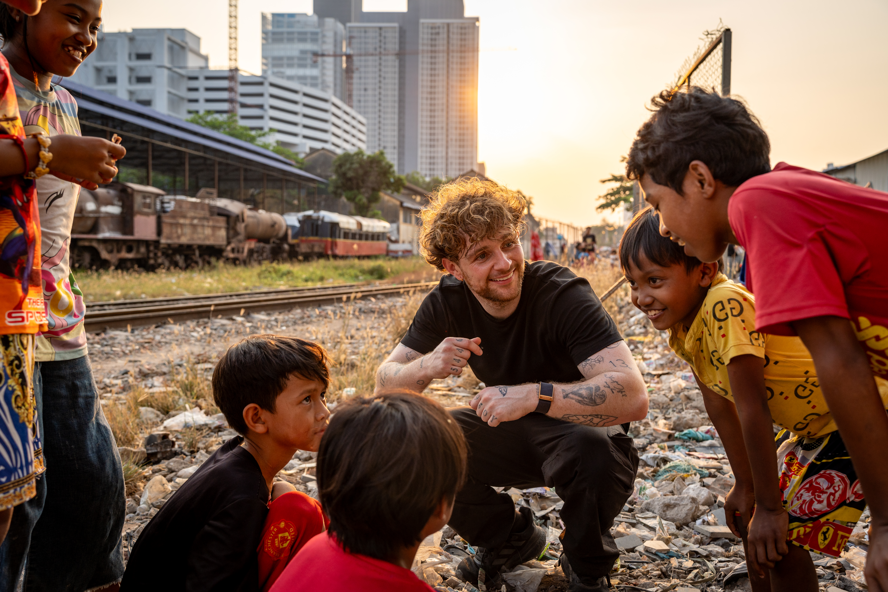
Tom Grennan sings with Theara age 14 and friends in the railway community center in Russey Keo district, Phnom Penh, Cambodia
CHILD FRIENDLY
SPACES: CAMBODIA
Last year, Tom Grennan travelled to Cambodia to see first-hand how UNICEF are supporting children in Phnom Penh.
Tom met 14-year-old Theara, who lives with his family in an area that poses many dangers to children — none more so than the live railway line that runs through the middle of the community.
Tom visited UNICEF-funded safe spaces that help children like Theara to access education and simply to play, out of harm's way.
“Soccer Aid has always been close to my heart, but being asked to see where the money that is raised goes has completely shifted my whole view on what Soccer Aid is about. UNICEF have helped to create this community centre and this safe place for children to learn and play, to just be kids. I’m proud to be a part of it.”- Tom Grennan
“QUOTE OR PULL-OUT TEXT
IN FUSE V2 REGULAR.”
“QUOTE OR PULL-OUT TEXT
IN FUSE V2 REGULAR.”
Notes:
As part of our Soccer Aid for UNICEF Academy lessons, we will be learning about when popstar Tom Grennan travelled to Cambodia to see how UNICEF is supporting children like Theara.
We will be watching a film and learning more about how UNICEF support children around the world in lots of different ways.

Slide 8
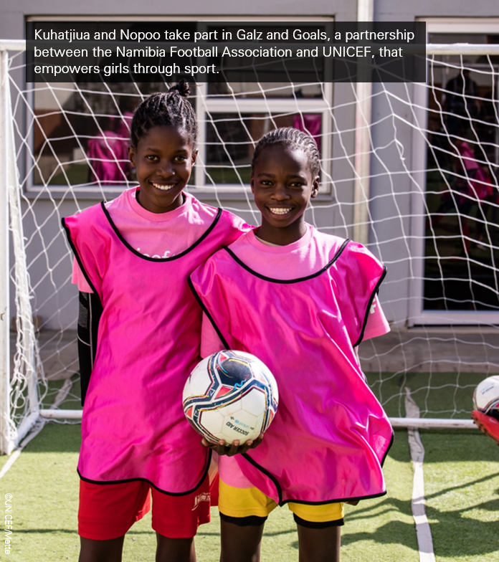




£2
could buy a bednet to protect a family from malaria
EVERY
POUND
YOU
RAISE
MAKES
A
DIFFERENCE
£5
could provide enough tablets to purify 1,903 litres of water
£10
could help vaccinate over 50 children against deadly and devastating diseases
£20
could buy thermal blankets to keep 3 babies warm in an emergency
Notes:
And every pound you raise make a huge difference. The money you help raise go directly towards UNICEF’s work for children all over the world, and as little as £1 can have a huge impact.

Slide 9
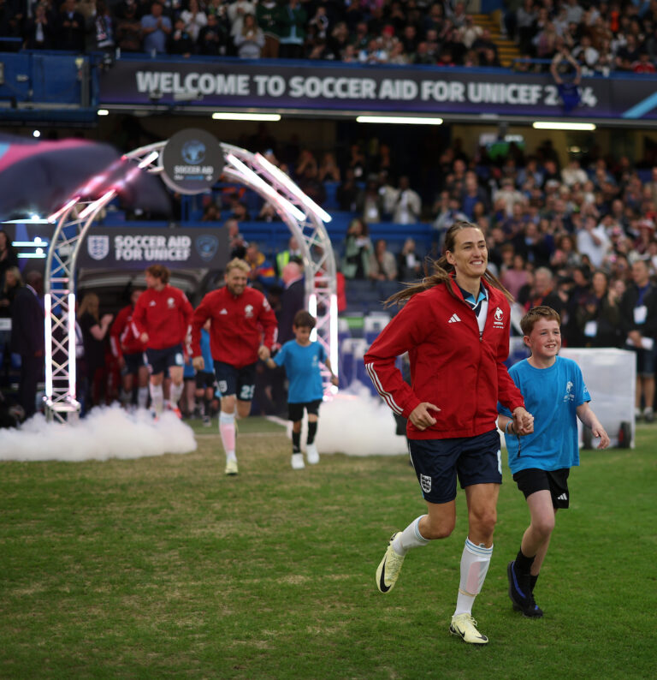
BONUS CHALLENGE
Would you like to enter the Soccer Aid for UNICEF Primary School Competition? You could be in with a chance of becoming one of the Soccer Aid for UNICEF 2025 mascots!
Design the t-shirt that child mascots will wear when they walk onto the pitch with the Soccer Aid players.
The design needs to be imaginative, impactful, and meaningful, reflecting UNICEF’s values and/or the fundamental rights of children worldwide.
As a school, we will be selecting our top 5 entries that will be submitted to the judging panel at UNICEF UK.
You will be given templates to design your t-shirt in class.
Good luck!
Notes:
Note this is a Primary school competition only – please disregard if you are a Secondary school and move to the next slide.

Slide 10

BONUS CHALLENGE
Would you like to enter the Soccer Aid for UNICEF Secondary School Competition? You could be in with a chance of winning tickets to Soccer Aid for UNICEF 2025!
Design an A4 poster that reflects UNICEF's values and/or the fundamental rights of children worldwide. The design needs to be imaginative, impactful, and meaningful, and the winning design will be printed in the Soccer Aid Matchday Programme.
As a school, we will be selecting our top 5 entries that will be submitted to the judging panel at UNICEF UK.
Good luck!
Notes:
Note this is a Secondary school competition only – please disregard if you are a Primary school and move to the next slide.

Slide 11
Our school plans:
Notes:
Customise this slide with your school plans.
For example:
Our fundraising target is £[AMOUNT]
We’ll ask you to bring in £3 if you can to take part in the challenges, a letter will be given to you.
We will be completing challenges from [DATE] to [DATE]

Slide 12
HAVE FUN &
GOOD LUCK!
Notes:
This assembly is designed to help you introduce the Soccer Aid for UNICEF Academy in your school. These slides can be tailored to fit your plans and school context.

