Slide 1


The BIG Soccer Aid for UNICEF Academy Quiz

Slide 2
What does the ‘C’ in UNICEF stand for?
Answer -
Children

Slide 3
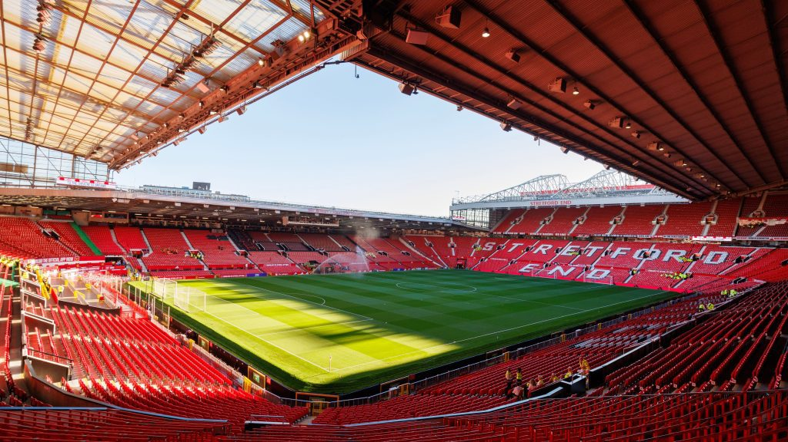
2. Soccer Aid for UNICEF is at Old Trafford this year. Which city is Old Trafford in?
Answer - Manchester

Slide 4

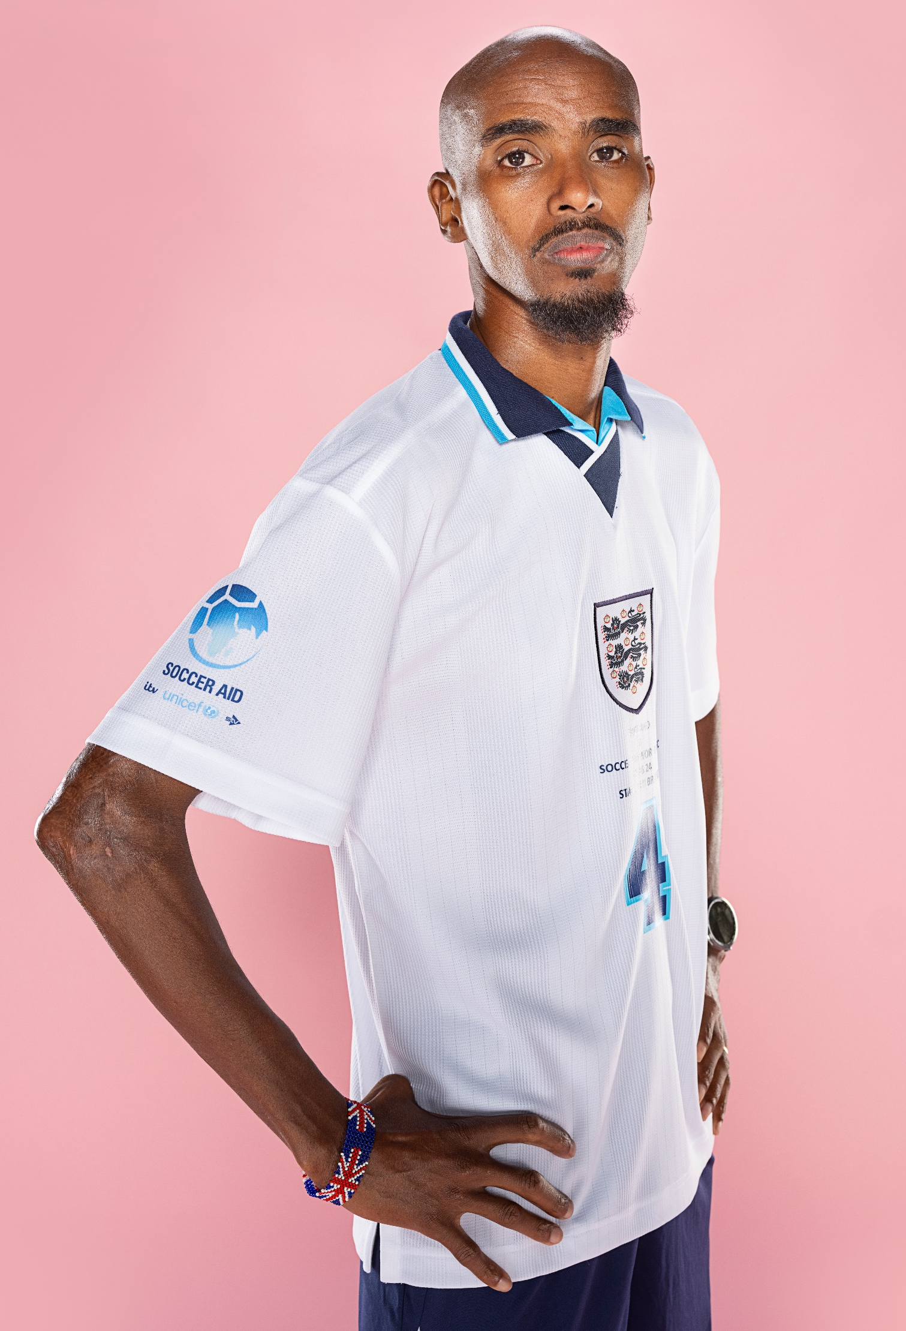

3. Can you name these 3 Soccer Aid for UNICEF players?
Sam Thompson
Diamond
Sir Mo Farah

Slide 5
4. There are 196 countries in the world. How many countries does UNICEF work in?
100
50
190+
89
Answer – c)190+

Slide 6
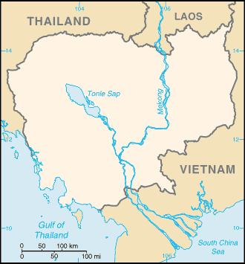
5. Which country that UNICEF works in is not labelled here?
Answer -
Cambodia

Slide 7
6. When did Soccer Aid for UNICEF begin?
2020
2014
1995
2006
Answer - d) 2006

Slide 8
7. How much money has Soccer Aid raised for UNICEF?
Answer – c)£106 million
£10 million
£75 million
£106 million
£54 million

Slide 9
8. Which of these is not the Rights of a Child?
Answer – c) The Right to Watch TV
The Right to Play
The Right to an Education
The Right to Watch TV

Slide 10
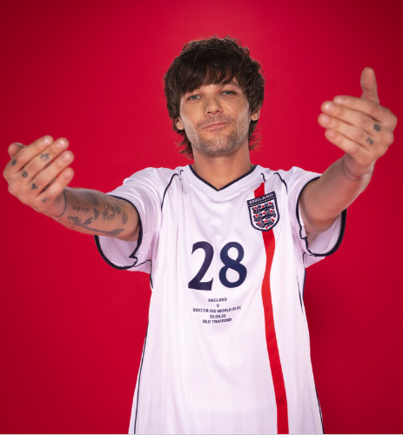
9. Can you name this Soccer Aid for UNICEF 2025 player?
Answer –
a) Louis Tomlinson
Louis Tomlinson
Robbie Williams
David James
Sir Mo Farah

Slide 11
10. Finish the Soccer Aid for UNICEF tagline
Play for every….
child

Slide 12

11. Which country that UNICEF works in does this flag belong to?
Answer - Romania

Slide 13
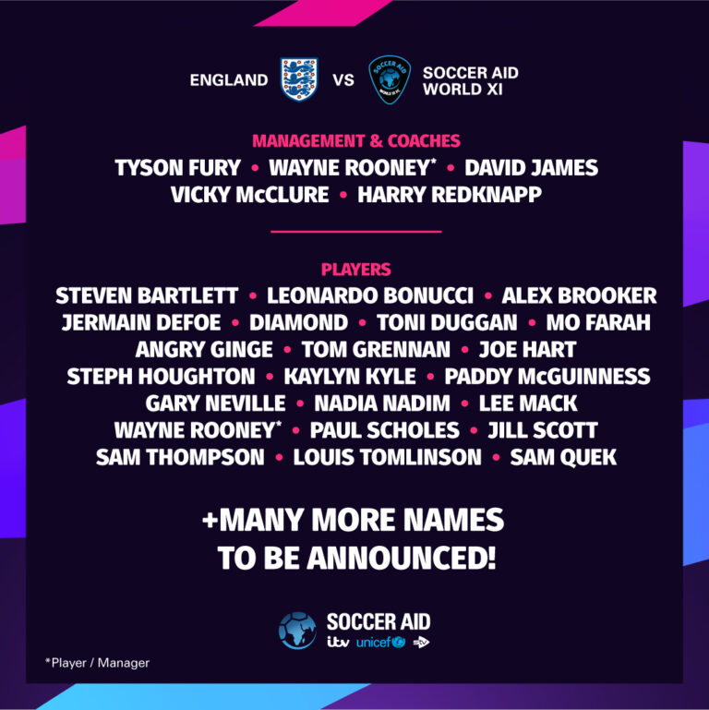
12. Can you name 3 people who are playing in this years Soccer Aid for UNICEF so far?
Notes:
More names might have been announced since the graphic was added. For the latest line-up, see here: https://www.socceraid.org.uk/line-up/

Slide 14

13. Who was the first female captain at Soccer Aid for UNNCEF?
Answer – Jill Scott

Slide 15

14. Which country that UNICEF works in does this flag belong to?
Answer - Bangladesh

Slide 16
15. One of the ways that UNICEF supports children around the world is by providing child friendly spaces for protection, education and comfort.
True
False
Answer – a) True!

Slide 17
16. What year was UNICEF founded?
1952
1882
1946
The United Nations International Children's Emergency Fund (UNICEF) was established in 1946, in the aftermath of World War II.
Answer-c) 1946

Slide 18
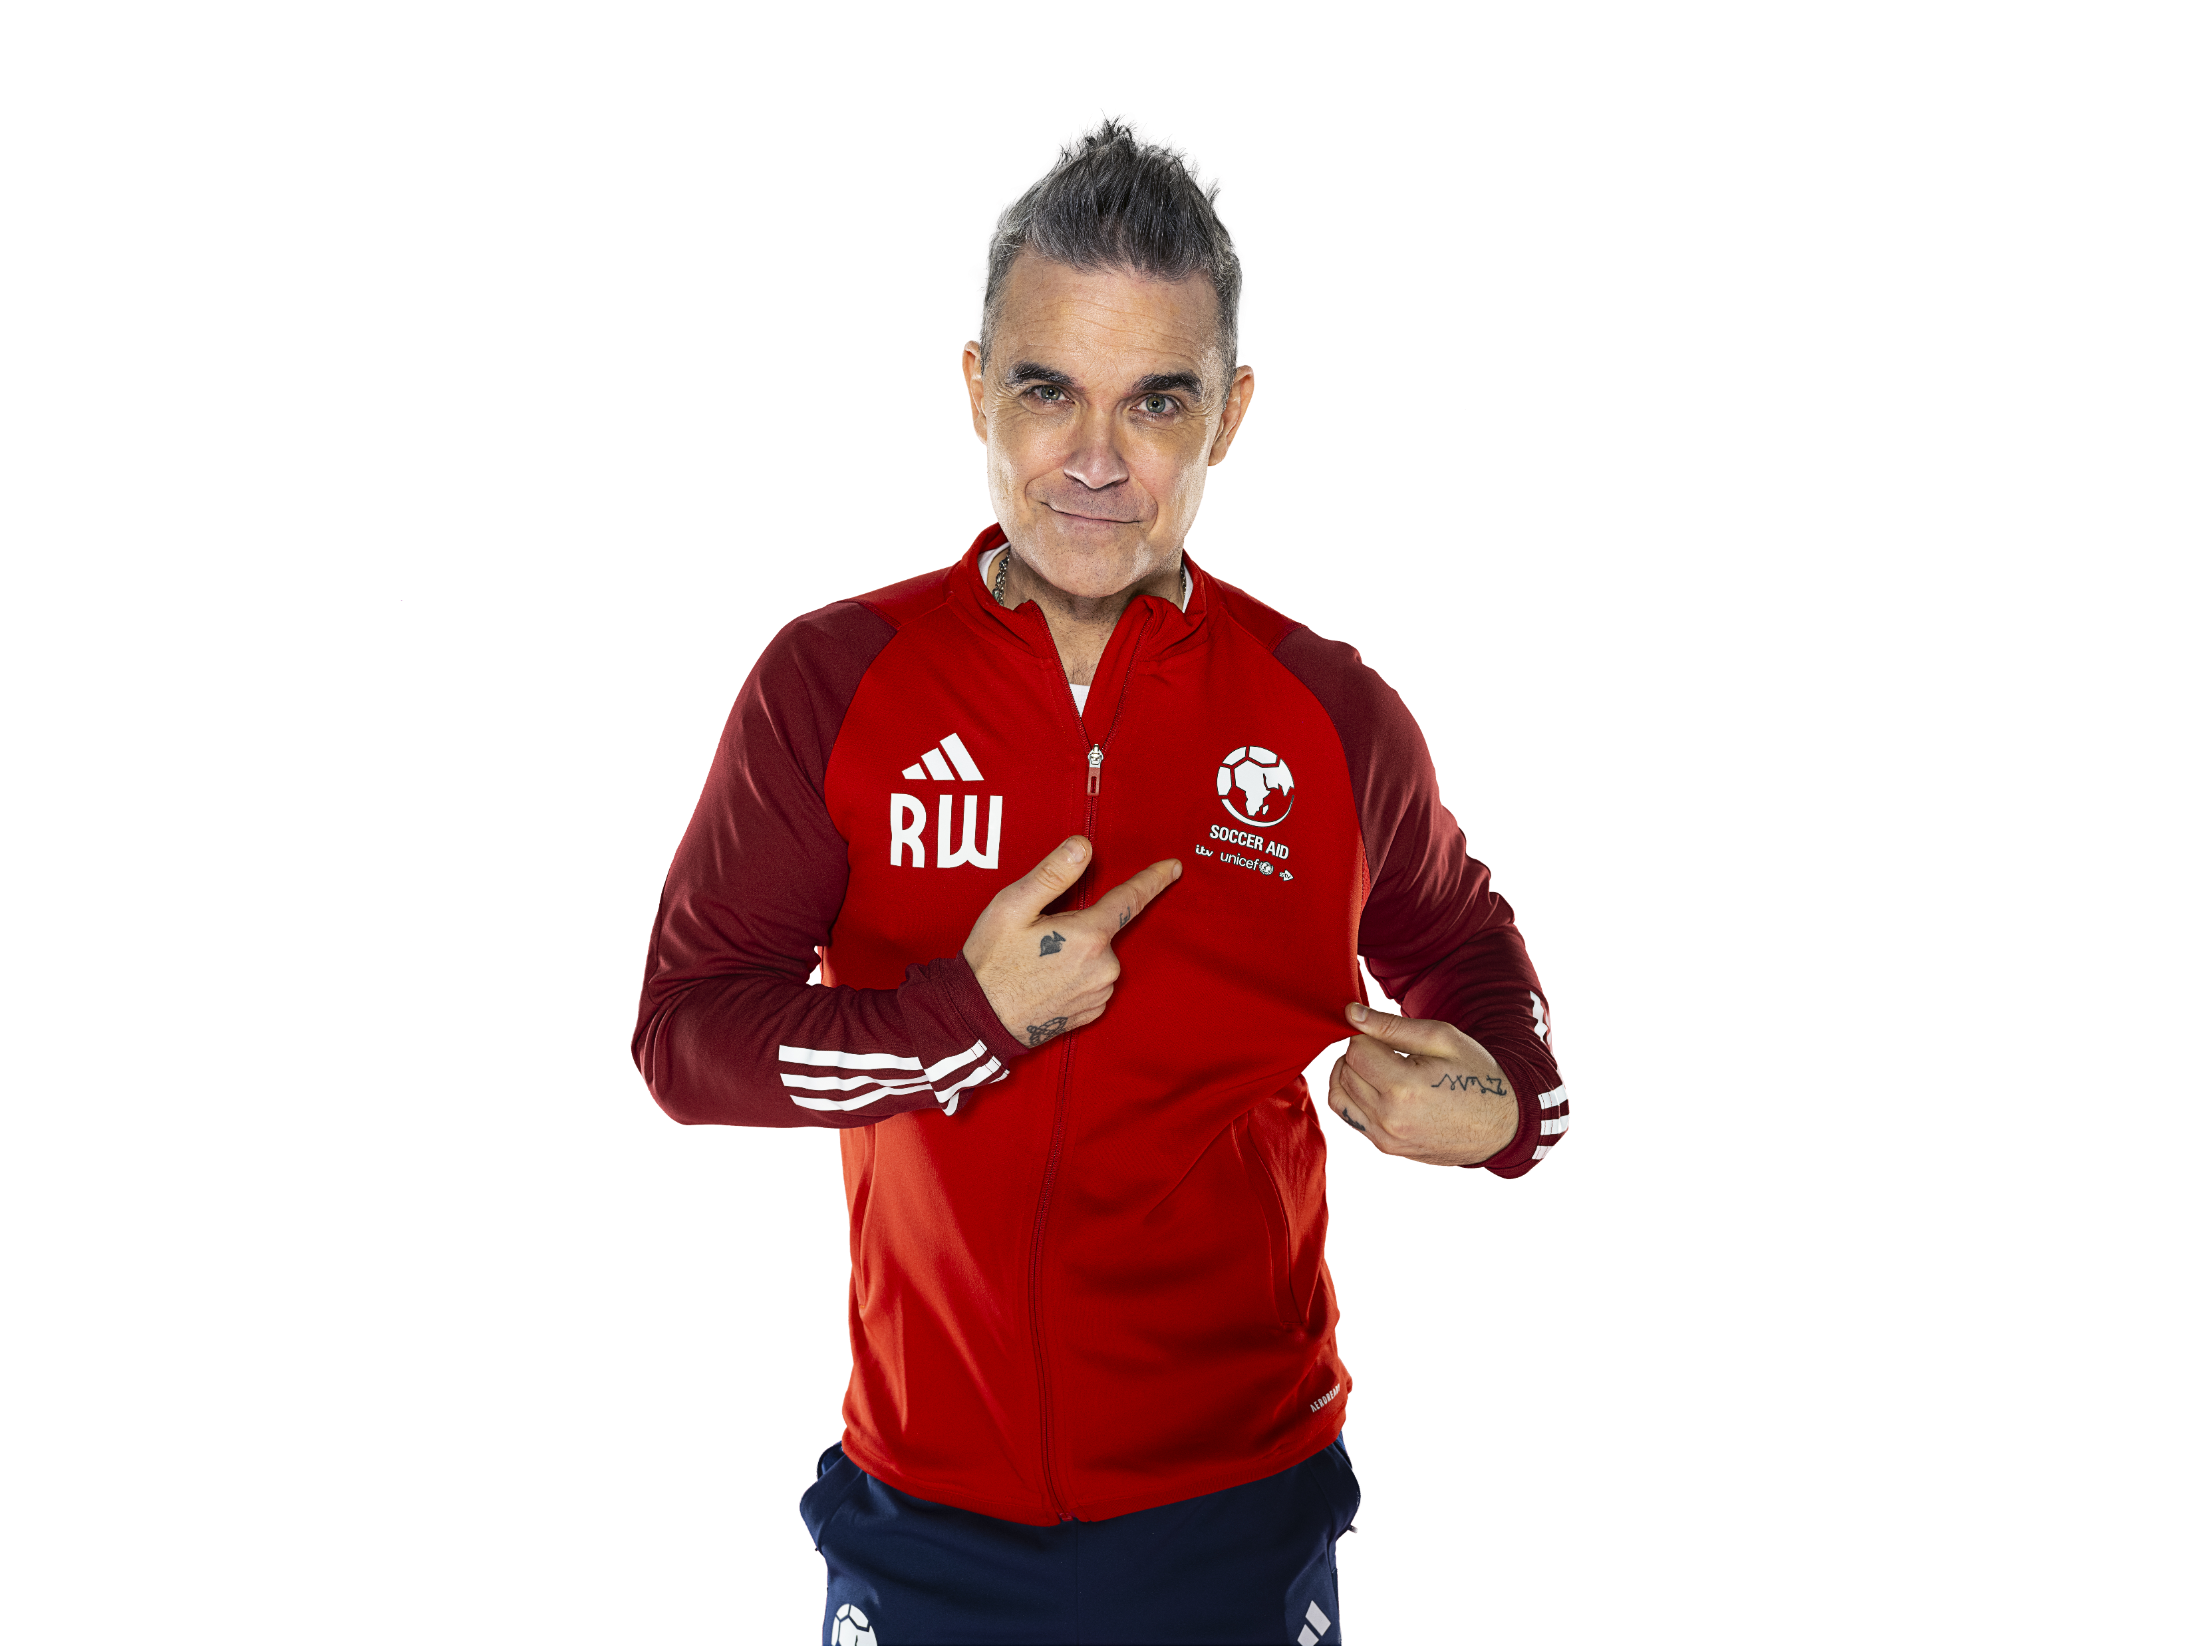
17. Do you know which musician created Soccer Aid?
Answer-
Robbie Williams!

Slide 19
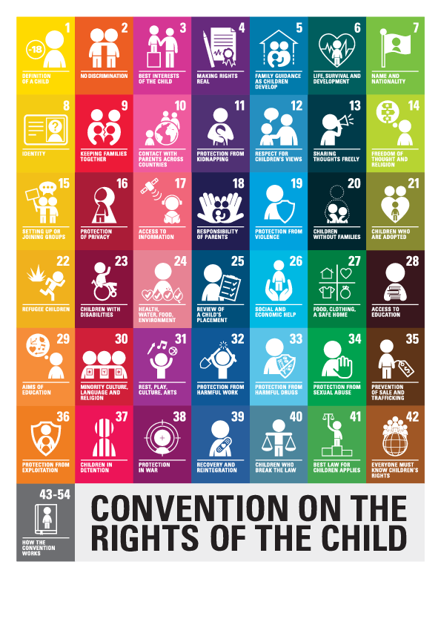
18. Other than the Right to Play, can you name 3 other Rights of a Child?
Notes:
https://www.unicef.org.uk/what-we-do/un-convention-child-rights/

Slide 20
19. One of the ways that UNICEF supports children around the world is by vaccinating them against dangerous diseases.
True
False
UNICEF provides more than 2 billion vaccine doses each year, reaching 45% of the world's children under five.
Answer – a) True!

Slide 21

20. Which country that UNICEF works in does this flag belong to?
Answer – Cambodia

Slide 22
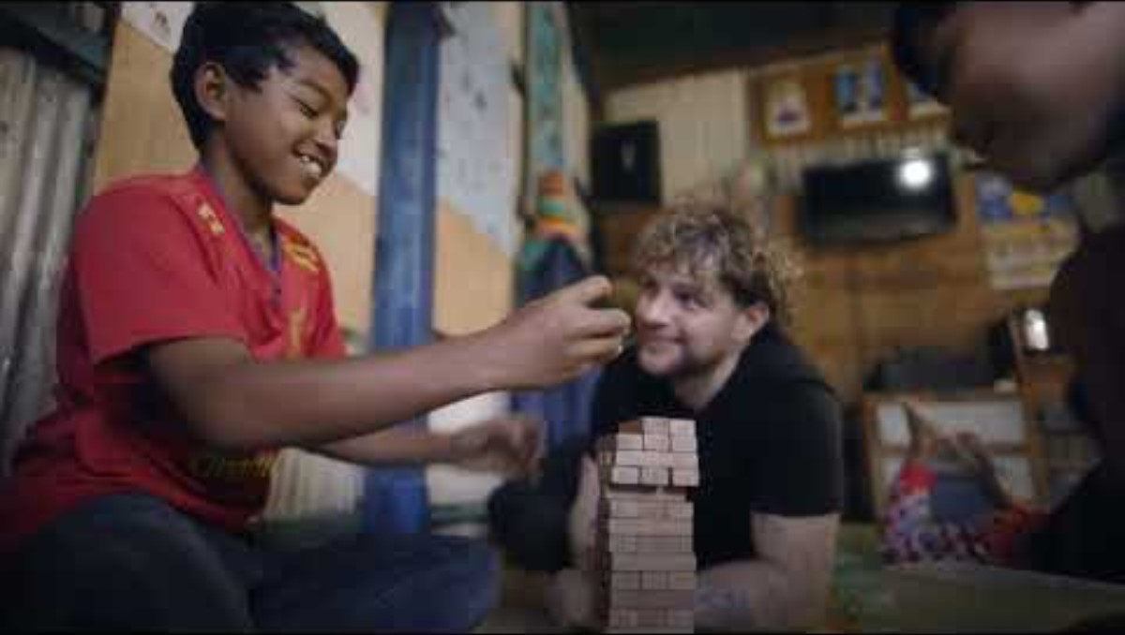
Take a look at when Soccer Aid popstar Tom Grennan visited Cambodia last year:
*Contains some scenes that may be upsetting.
Notes:
Soccer Aid for UNICEF Academy | Tom Grennan meets Theara in Cambodia

Slide 23
WELL DONE!

