Slide 1


The BIG Soccer Aid for UNICEF Academy Quiz

Slide 2
1. What does the ‘C’
in UNICEF stand for?
Cats
Cabbage
Children
Answer – c) Children

Slide 3
2. What is Soccer Aid for UNICEF?
A charity football match
A charity rugby match
A dance performed by football players
Answer – a) A charity football match

Slide 4

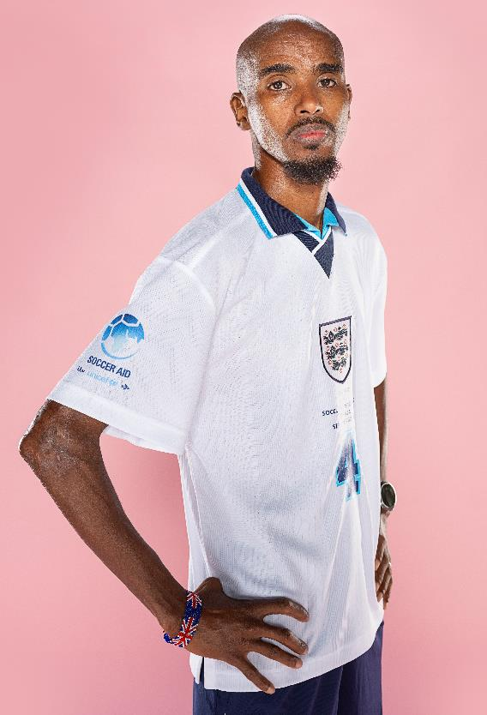
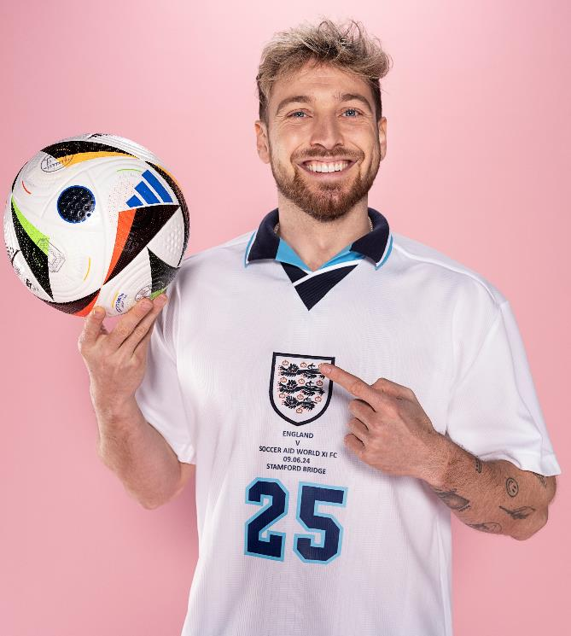
3. Celebrities play in Soccer Aid for UNICEF. Can you name these 3 celebrities?
Sam Thompson
Diamond
Sir Mo Farah

Slide 5
4. One of the ways that UNICEF supports children around the world is by providing child friendly spaces for protection, education and comfort.
True
False
Answer – a) True!
Notes:
Soccer Aid for UNICEF Academy | Tom Grennan meets Theara in Cambodia

Slide 6
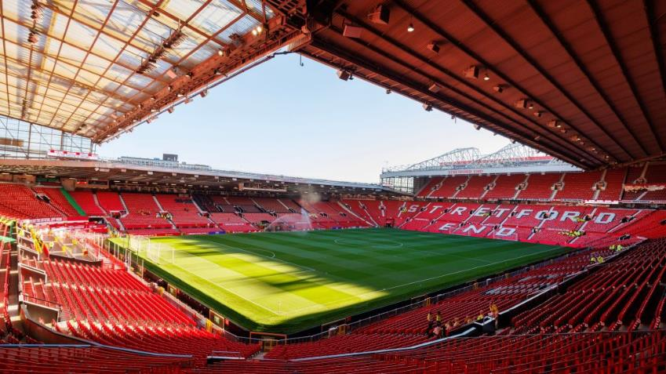
5. Soccer Aid for UNICEF is at Old Trafford this year. Which city is Old Trafford in?
Answer - Manchester

Slide 7
6. There are 196 countries in the world. How many countries does UNICEF work in?
100
50
190+
89
Answer – c)190+

Slide 8
7. When did Soccer Aid for UNICEF begin?
2020
2014
1995
2006
Answer - d) 2006

Slide 9
8. One of the ways that UNICEF supports children around the world is by making sure there's enough safe water to drink.
True
False
Answer – a) True!

Slide 10
9. How much money has Soccer Aid raised for UNICEF?
Answer – c)£106 million
£10 million
£75 million
£106 million
£54 million

Slide 11
10. Which of these is not the Rights of a Child?
Answer – c) The Right to Watch TV
The Right to Play
The Right to an Education
The Right to Watch TV

Slide 12


11. Can you name this Soccer Aid for UNICEF 2025 player?
Answer –
a) Louis Tomlinson
Louis Tomlinson
Robbie Williams
David James
Sir Mo Farah

Slide 13
12. Finish the Soccer Aid for UNICEF tagline
Play for every….
child

Slide 14

13. Which country that UNICEF works in does this flag belong to?
Answer - Romania

Slide 15

14. Who was the first female captain at Soccer Aid for UNNCEF?
Answer – Jill Scott

Slide 16

15. Which country that UNICEF works in does this flag belong to?
Answer - Bangladesh

Slide 17
16. What year was UNICEF founded?
1952
1882
1946
The United Nations International Children's Emergency Fund (UNICEF) was established in 1946, in the aftermath of World War II.
Answer-c) 1946

Slide 18
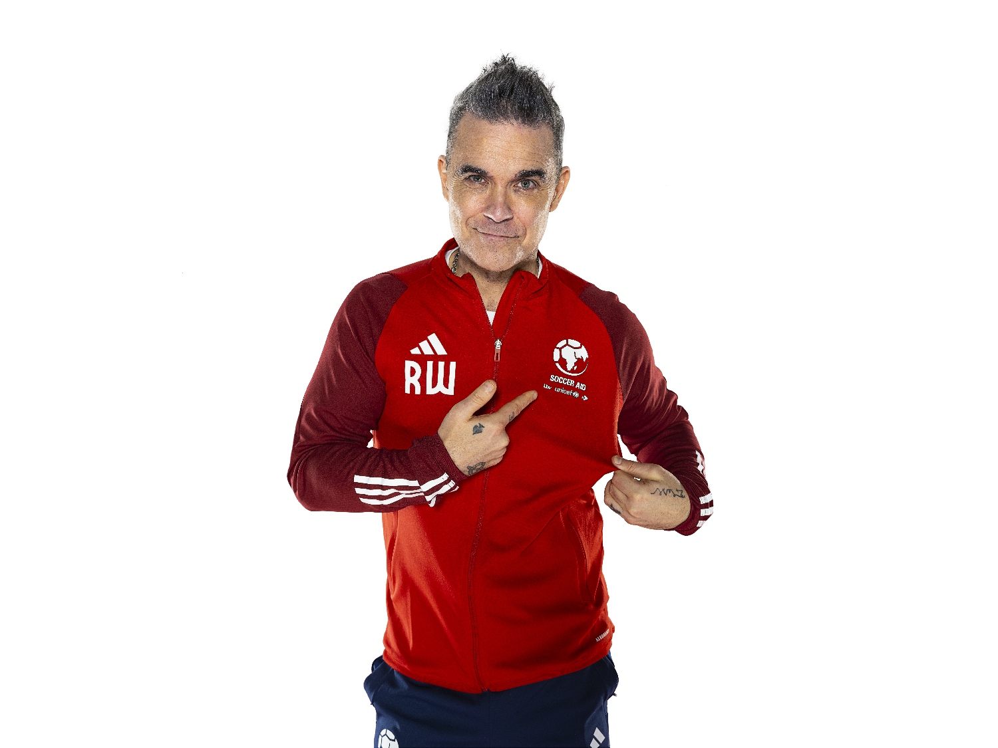
17. Do you know which musician created Soccer Aid?
Answer-
Robbie Williams!

Slide 19

18. Other than the Right to Play, can you name 3 other Rights of a Child?
Notes:
https://www.unicef.org.uk/what-we-do/un-convention-child-rights/

Slide 20
19. One of the ways that UNICEF supports children around the world is by vaccinating them against dangerous diseases.
True
False
Answer – a) True!

Slide 21

20. Which country that UNICEF works in does this flag belong to?
Answer – Cambodia

Slide 22
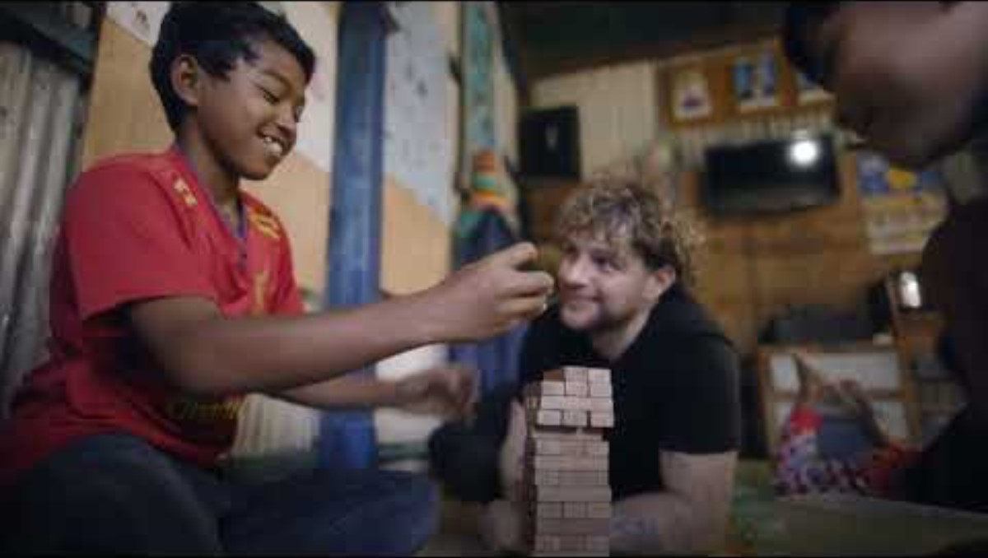
Take a look at when Soccer Aid popstar Tom Grennan visited Cambodia last year:
*Contains some scenes that may be upsetting.

Slide 23
WELL DONE!

